Slide 1
AP Human Geography
Unit 1 Geography: Its Nature and Perspective

Slide 2
Unit I Enduring Understandings
Early History of Geography
Geography: Its Nature and Perspectives
Greeks and Romans were first in western Eurasia
    Homer’s Iliad and Odyssey
    Aristotle observed Earth’s features and how they influenced human behavior
    Eratosthenes used geometry to calculate Earth’s circumference and coined the term geography
    Ptolemy, 500 years after Eratosthenes, summarized Greek knowledge of geography, including locations and sizes of continents; dominated European thought for 1,000 years.
Age of Exploration
    Christopher Columbus (1492) launched a new era in exploration, mapping, and description.
    Magellan first to circumnavigate the earth
    Gerardus Mercator – created a world map for sailors and is still widely used today
More Recently
    Carl Sauer (1889-1975) expanded the focus of geography beyond physical traits of the earth to include human activity
Geography, as a field of inquiry, looks at the world from a spatial perspective
B. Geography offers a set of concepts, skills, and tools that facilitate critical thinking and problem
solving
C. Geographical skills provide a foundation for analyzing world patterns and processes
D. Geospatial technologies increases the capability for gathering an analyzing geographic
information with applications to everyday life
E. Field experiences continue to be important means of gathering geographic information and
data

Slide 3
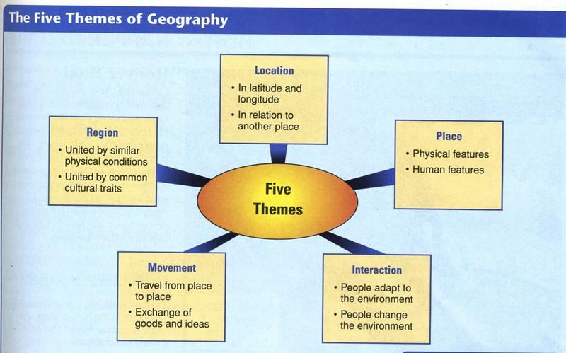
5 Themes of Geography

Slide 4
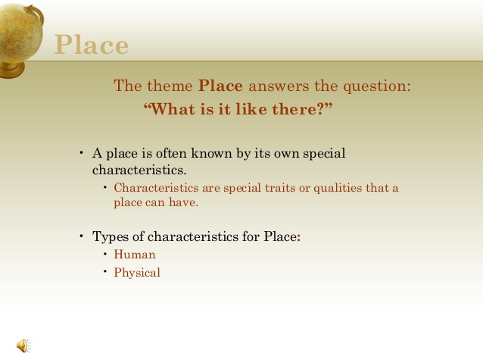

Slide 5
Place refers a specific point on Earth, distinguished by a particular characteristic. Every place occupies a unique location, or position, on Earth’s surface. Differentiates each location from another, like a finger print! Sound smell images you can develop a sense of place from somewhere you’ve never been tv=s, books, movies, people
Site the characteristics at the immediate location.
EX the location of a city, often chose for trade, defense or religion.
EX: Climate, labor force, soil type, human structures, water sources, topography, vegetation, latitude and elevation. The combination of physical features gives each place a distinctive character
EX: Humans have the ability to modify the characteristics of site. Cities like Boston, New York and San Francisco have all added lands to marshes, bays etc to add to their land
China in South China Sea, Island building 1:17: http://www.cnn.com/2015/10/28/asia/china-south-china-sea-disputes-explainer/index.html
Situation a way of describing where a place is based on the physical characteristics of the surrounding area. It is valuable way to indicate location, for two reasons
1. Finding an familiar place: Giving direction
based on current situation of place, It’s
down past the courthouse, on Main St
after the 3rd stoplight
2. Understanding the importance of a place: Situation helps us understand the importance of a location. Some just because they are accessible to other places.
EX: Istanbul is center for trading & distribution & distribution of goods between Asia, and Europe along the Bosporus Strait connecting the Mediterranean and Black seas and Russia

Slide 6
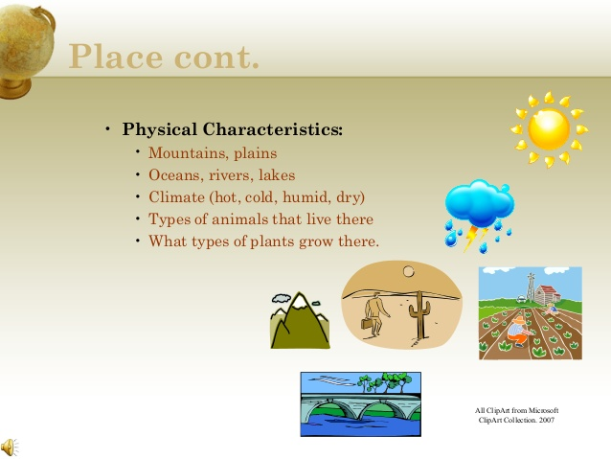

Slide 7
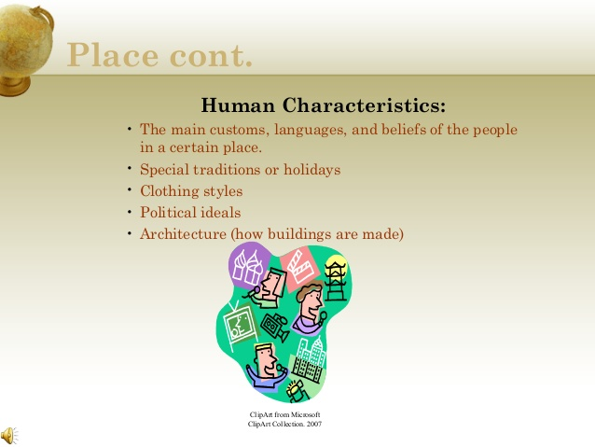

Slide 8
Places / Placelessness/ Mental Maps / Toponym
Place refers to all the Human and Physical Attributes in a Location
Often the human and physical attributes in a location give it a since of place that is different from other places
Human attributes can include elements like religions, languages, political organizations, clothing etc.
Placelessness
The loss of uniqueness of place in the cultural landscape every place looks, sounds, smells the same
With mass communication and the increasingly high technology, places become more and more similar so that locations lose distinctive since of place
Mental Maps: A representation of a portion of Earth’s surface based on what an individual knows about a place that contains personal impressions of what is in the place where the place is located
No two mental maps will be the same
A Toponym is the name of something on the Earth

Slide 9
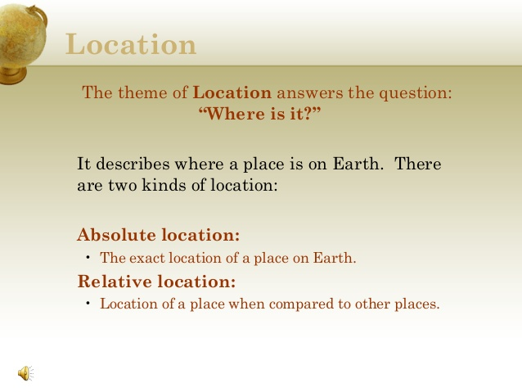

Slide 10
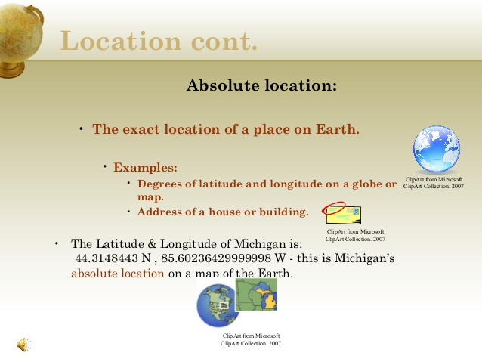

Slide 11
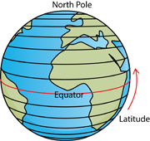
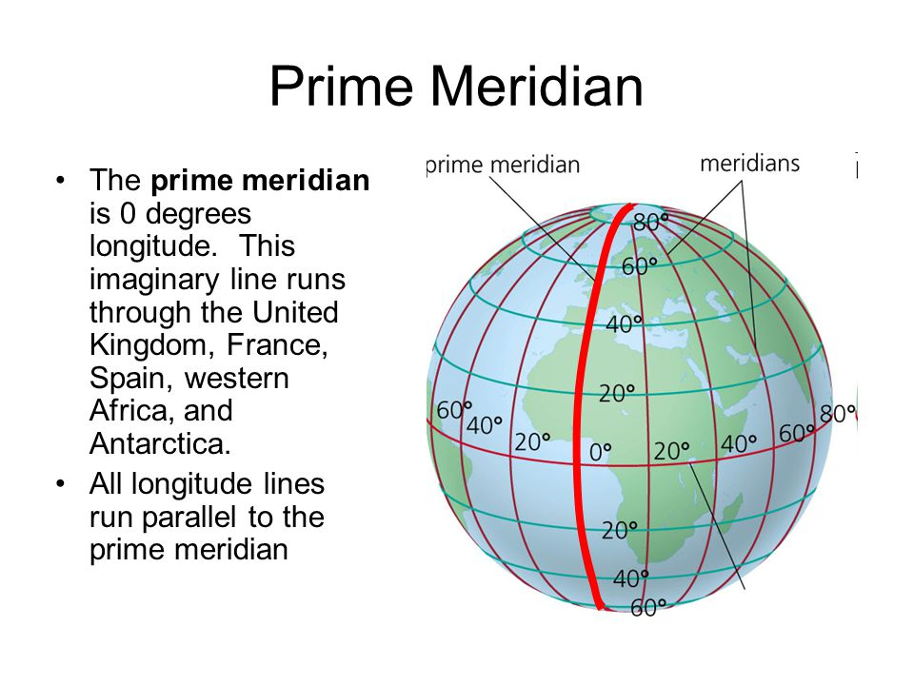
Latitude and Longitude
Latitude: the numbering system used to indicate the location of parallels drawn on a globe and measuring distance north and south of the Equator 0 degrees. Parallel: circle drawn around the globe parallel to the equator and at right angles to the meridians
Longitude: The numbering system used to indicate the location of meridians drawn on a globe and measuring distance east and west of the prime meridian 0 degrees, Greenwich England

Slide 12
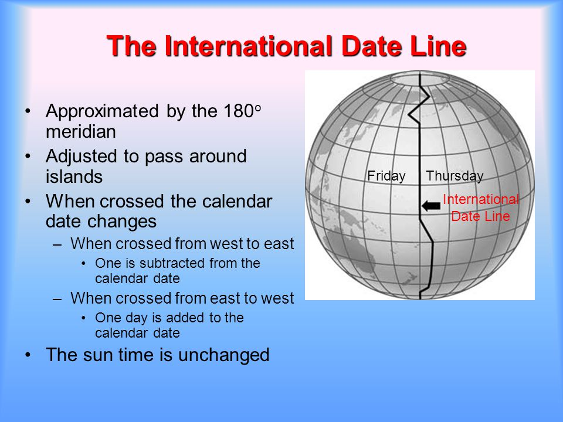
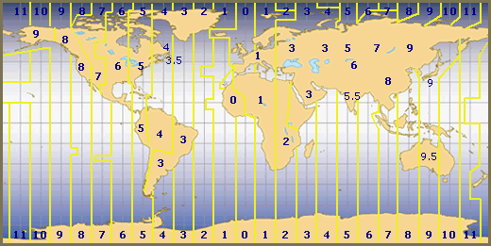
International Date Line / Time Zones

Slide 13
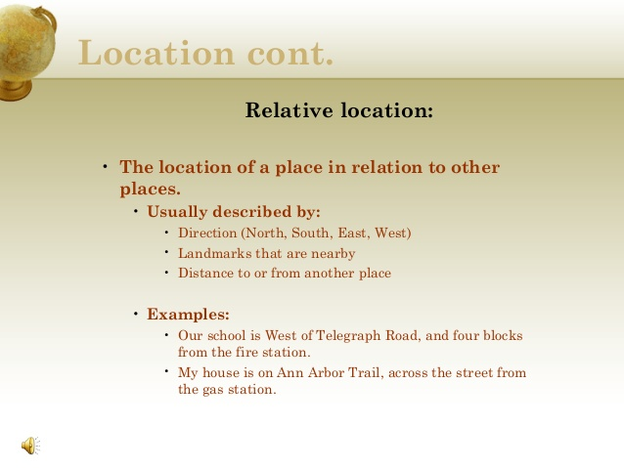

Slide 14
Density: is the number of things—which could be people, animals, plants, or objects—in a certain area. The frequency something occurs
Arithmetic density: Number of objects in an area, commonly used to compare distribution of population in different countries. (# people / sq. kilometer / mile
Physiological density: Number of persons per unit of area suitable for agriculture. Could mean a country has difﬁculty growing enough food.
Agricultural density: Number of farmers per unit area of farmland. Could mean that a country has inefﬁcient agriculture.
Housing density-: Number of dwelling units per unit of area -- may mean people live in overcrowded housing
Pattern How things are arranged in space
Described by geometric shapes like linear, such as the arrangement of houses along a street or squares of many cities blocks. Lack of pattern = Random
Concentration: how closely things are related to one another a space. Clustered or Disbursed
Distribution refers to the way something is spread out or arranged over a geographic area.
The concept of distribution can be applied to nearly everything on Earth, from animal and plant species, to disease infections, weather patterns, and man-made structures

Slide 15
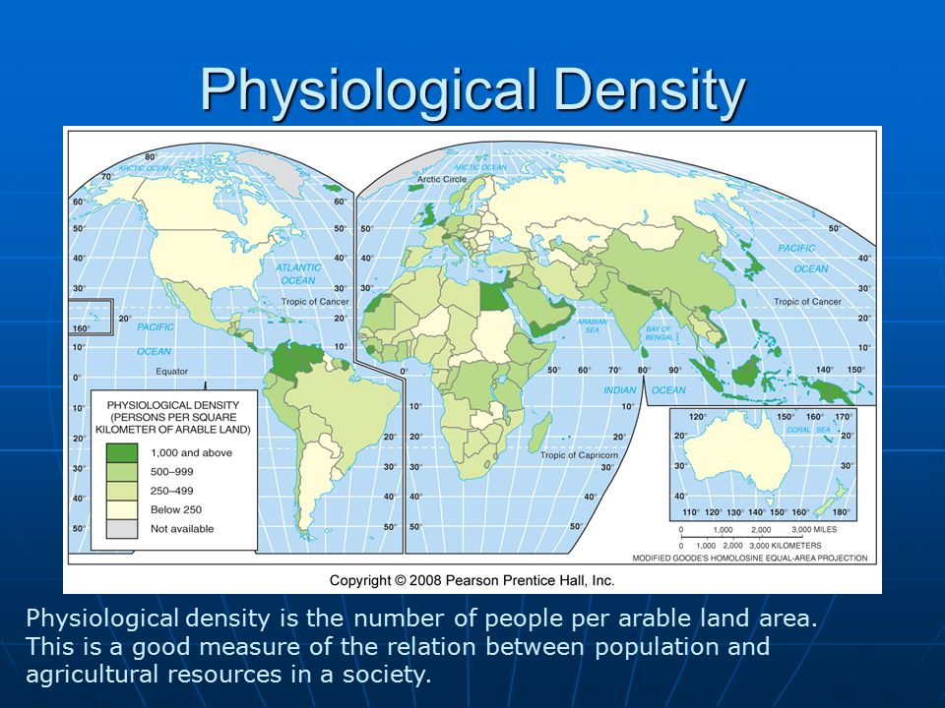
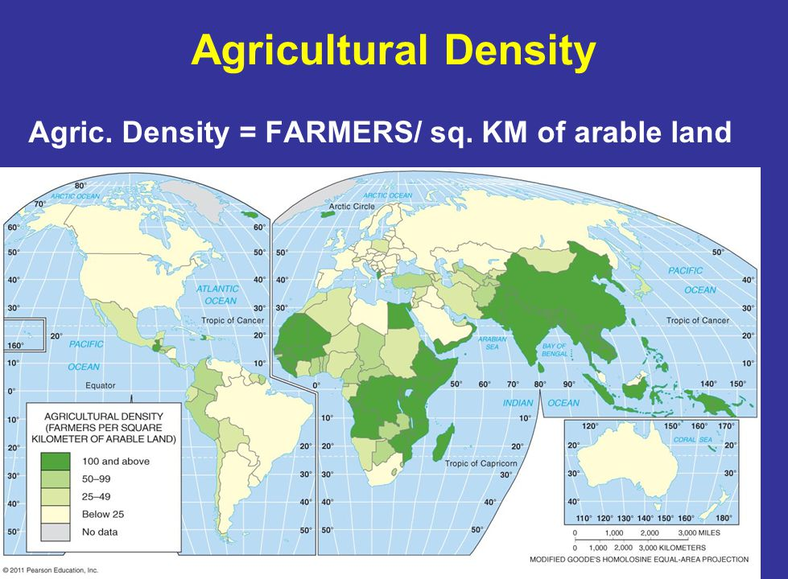
Density Maps

Slide 16
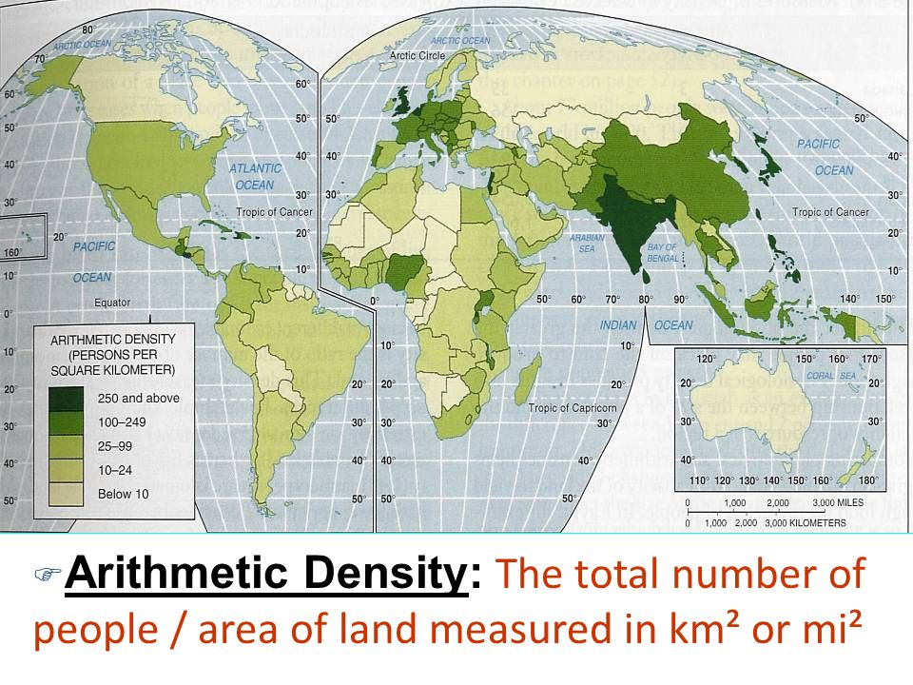
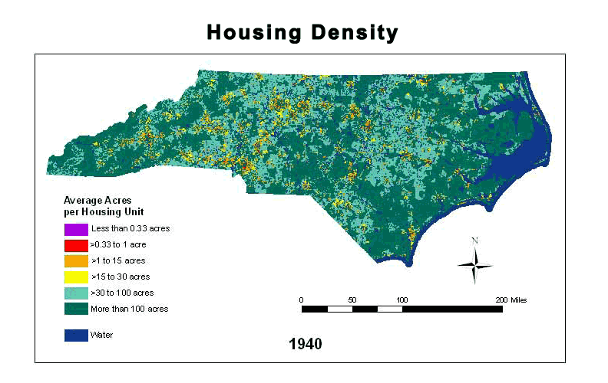
Density Maps

Slide 17
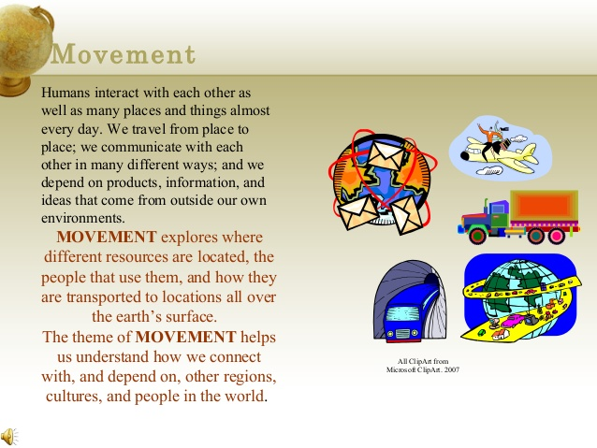

Slide 18
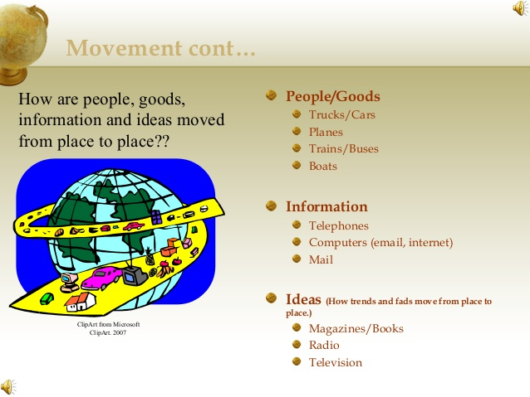

Slide 19
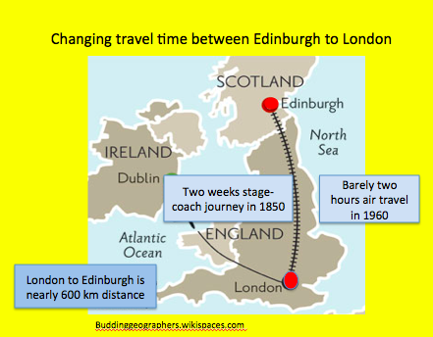
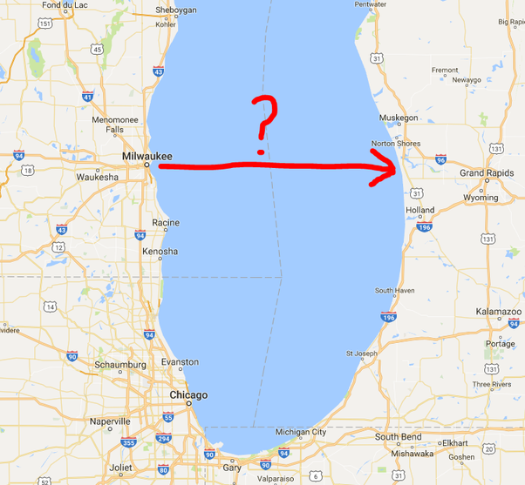
Space-Time Compression is the reduction in time it takes for something to reach another place because of a change in technology
Proximity The nearness to important features. Distance can be measured in terms of geography and is given in a type of measurement, such as miles, meters or kilometers, It may be a straight line (as the crow flies) or travel distance using a route that turns and twists, (Milwaukee to Kalamazoo is 139 miles by air but 250 by car because the route goes around the tip of Lake Michigan
Space-Time Compression
Proximity

Slide 20
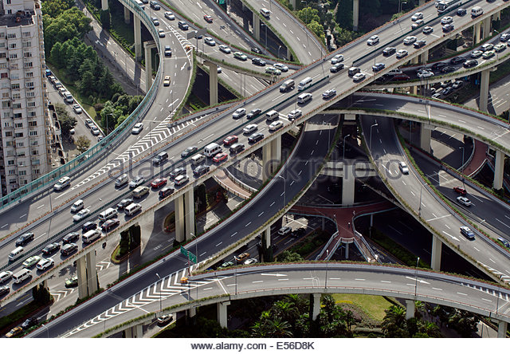
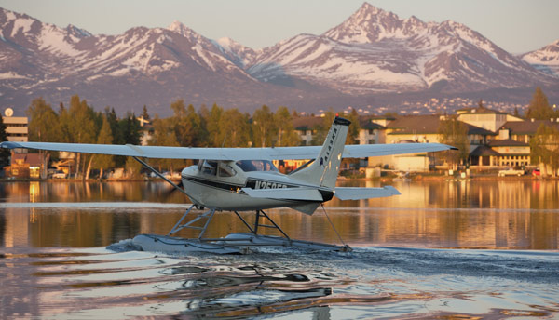
Movement
Connectivity Directness of routes linking pairs of places
Accessibility: The relative ease with which a destination may be reached from other locations

Slide 21
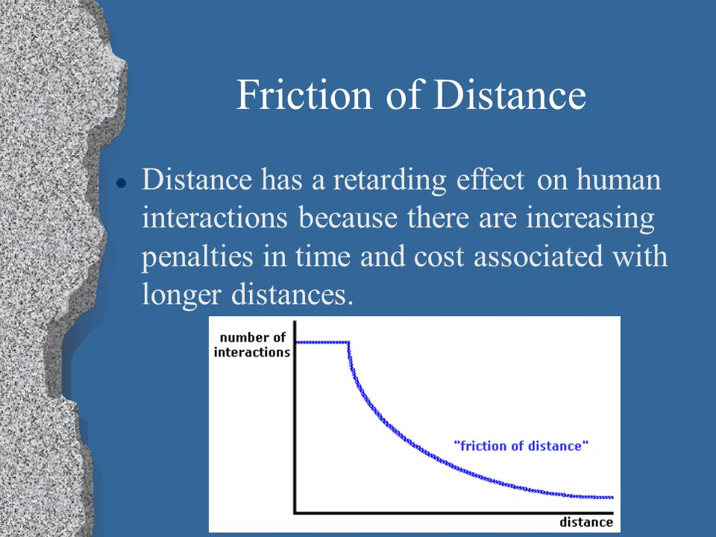
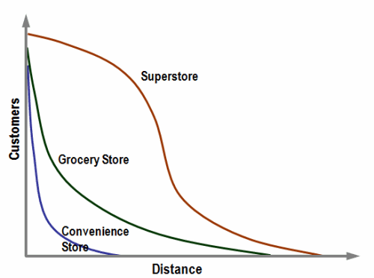
Movement
Friction of Distance is based on the notion that distance usually requires some amount of effort, money, and/or energy to overcome. Because of this "friction," spatial interactions will tend to take place more often over shorter distances; quantity of interaction will decline with distance.
Distance Decay occurs when the intensity of some phenomenon decreases as distance from it increases. Going to a sporting event is highly drawing, while going to a fast food restaurant is not

Slide 22
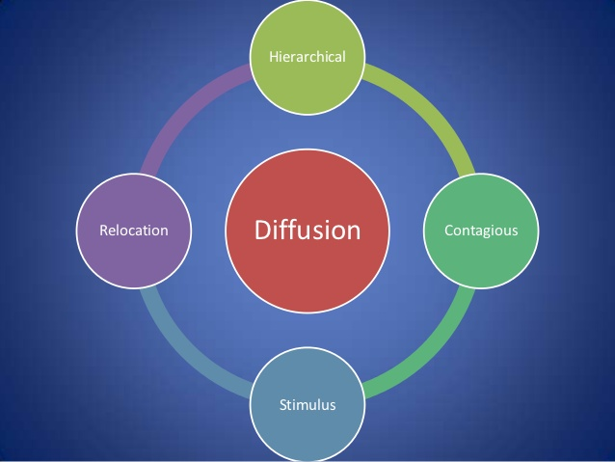
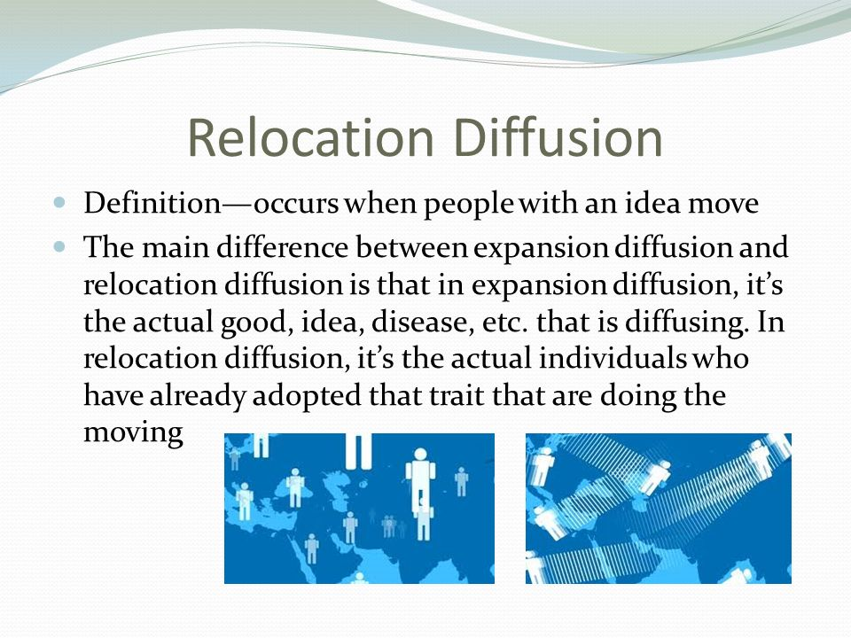
Diffusion is the process by which a characteristic spreads across space from one place to another over time. Elrod 10 min: https://www.youtube.com/watch?v=lkf_p79jKVU
Types of Diffusion
Relocation Diffusion: The diffusion of a characteristic as people move from place to place Example – spread of Spanish language to South America

Slide 23
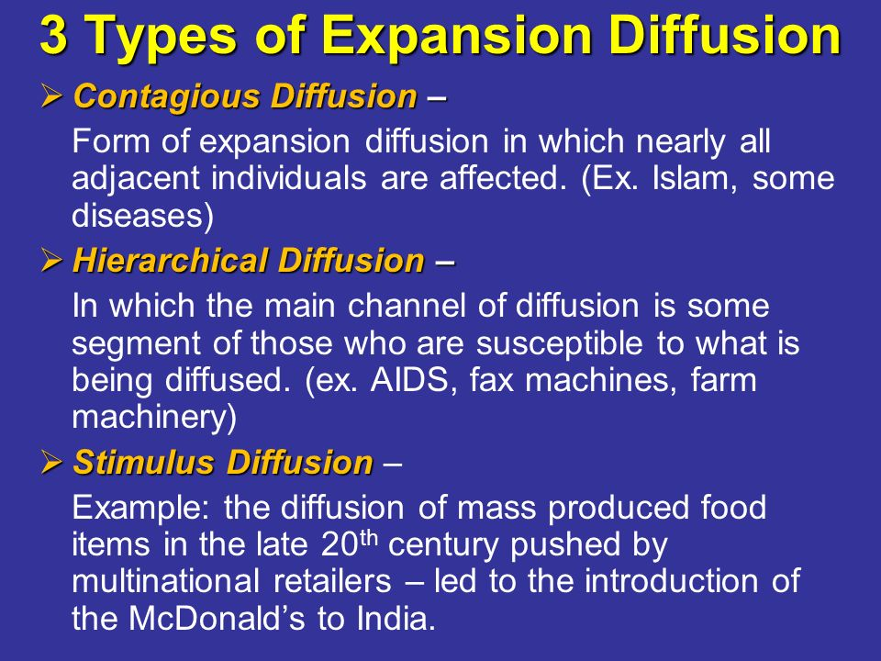
Expansion Diffusion: spread of a characteristics from hearth through various means

Slide 24
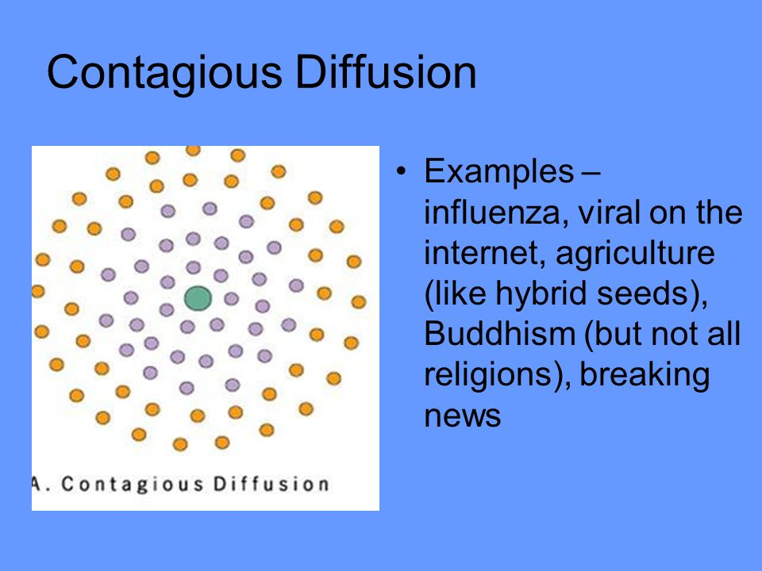
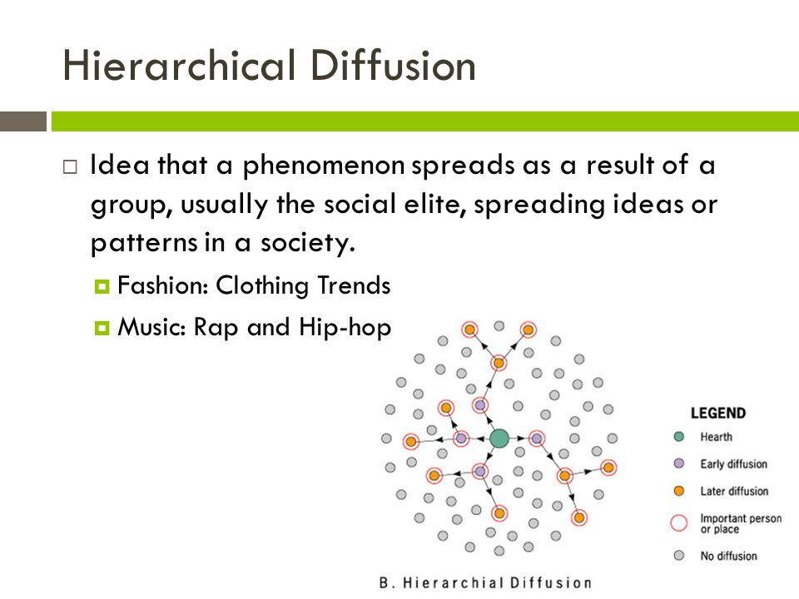
Types of Expansion Diffusion
Contagious Diffusion: The rapid, widespread diffusion of a characteristic through the population
Hierarchal Diffusion: The spread of an idea from persons or nodes of authority or power to other persons or places

Slide 25
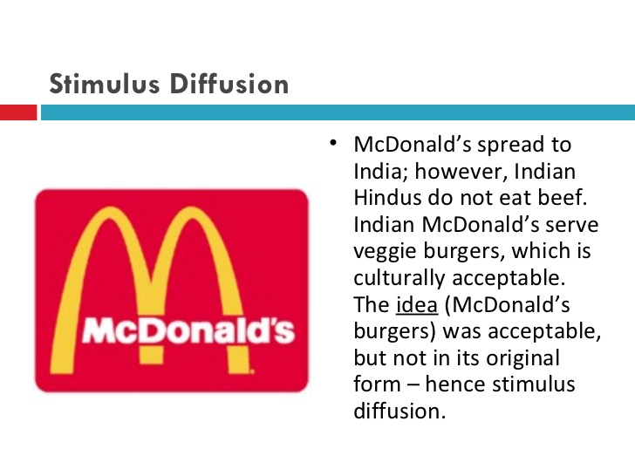
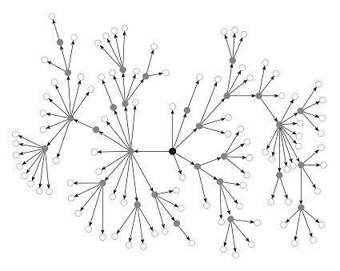
Stimulus Diffusion: Takes part of an idea and spreads that idea to create an innovative product. Example: Rap music. Can you think of any more?

Slide 26
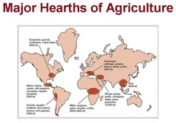
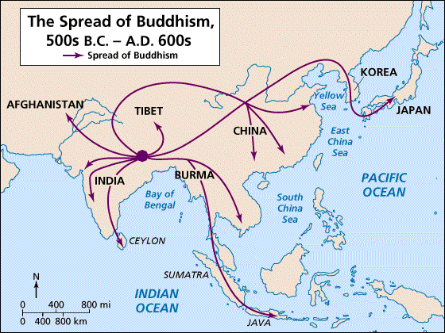
A hearth is the place which an innovation or cultural change originates.

Slide 27
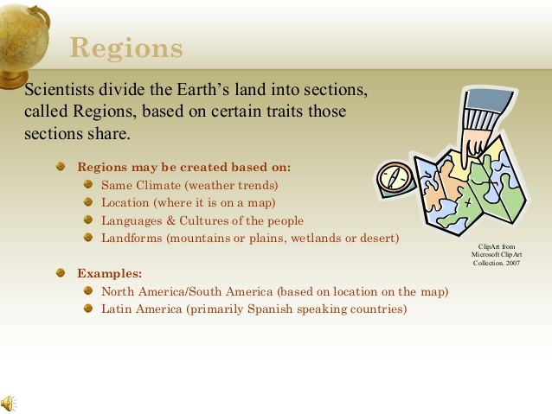

Slide 28
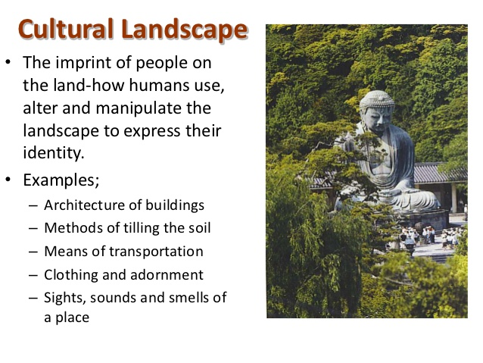
“The physical features, economic features, and cultural features that make up a region are called its cultural landscape.”
Types of Regions
Formal Regions also called Uniform Region is an area within which everyone shares in common one or more distinctive characteristics. (common language, economic activity like producing a similar crop, or environmental property like a climate.
Functional Regions: are organized around a focal point and are defined by an activity that occurs across the region. These regions are often united by networks of communication and transportation that are centered on a node so they are also known as nodal regions

Slide 29
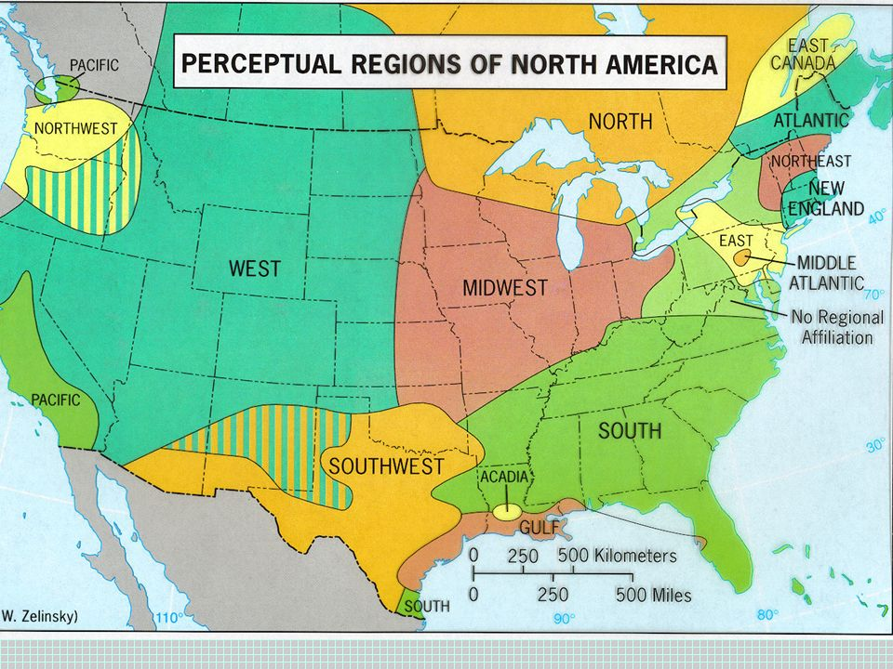
Perceptual or Vernacular Regions : Defined by an informal sense of place that people believe exists as part of their cultural identity (U.S. Cultural, Political Landscape 8 min https://www.youtube.com/watch?v=BZwvl4f88Cc&feature=youtu.be

Slide 30
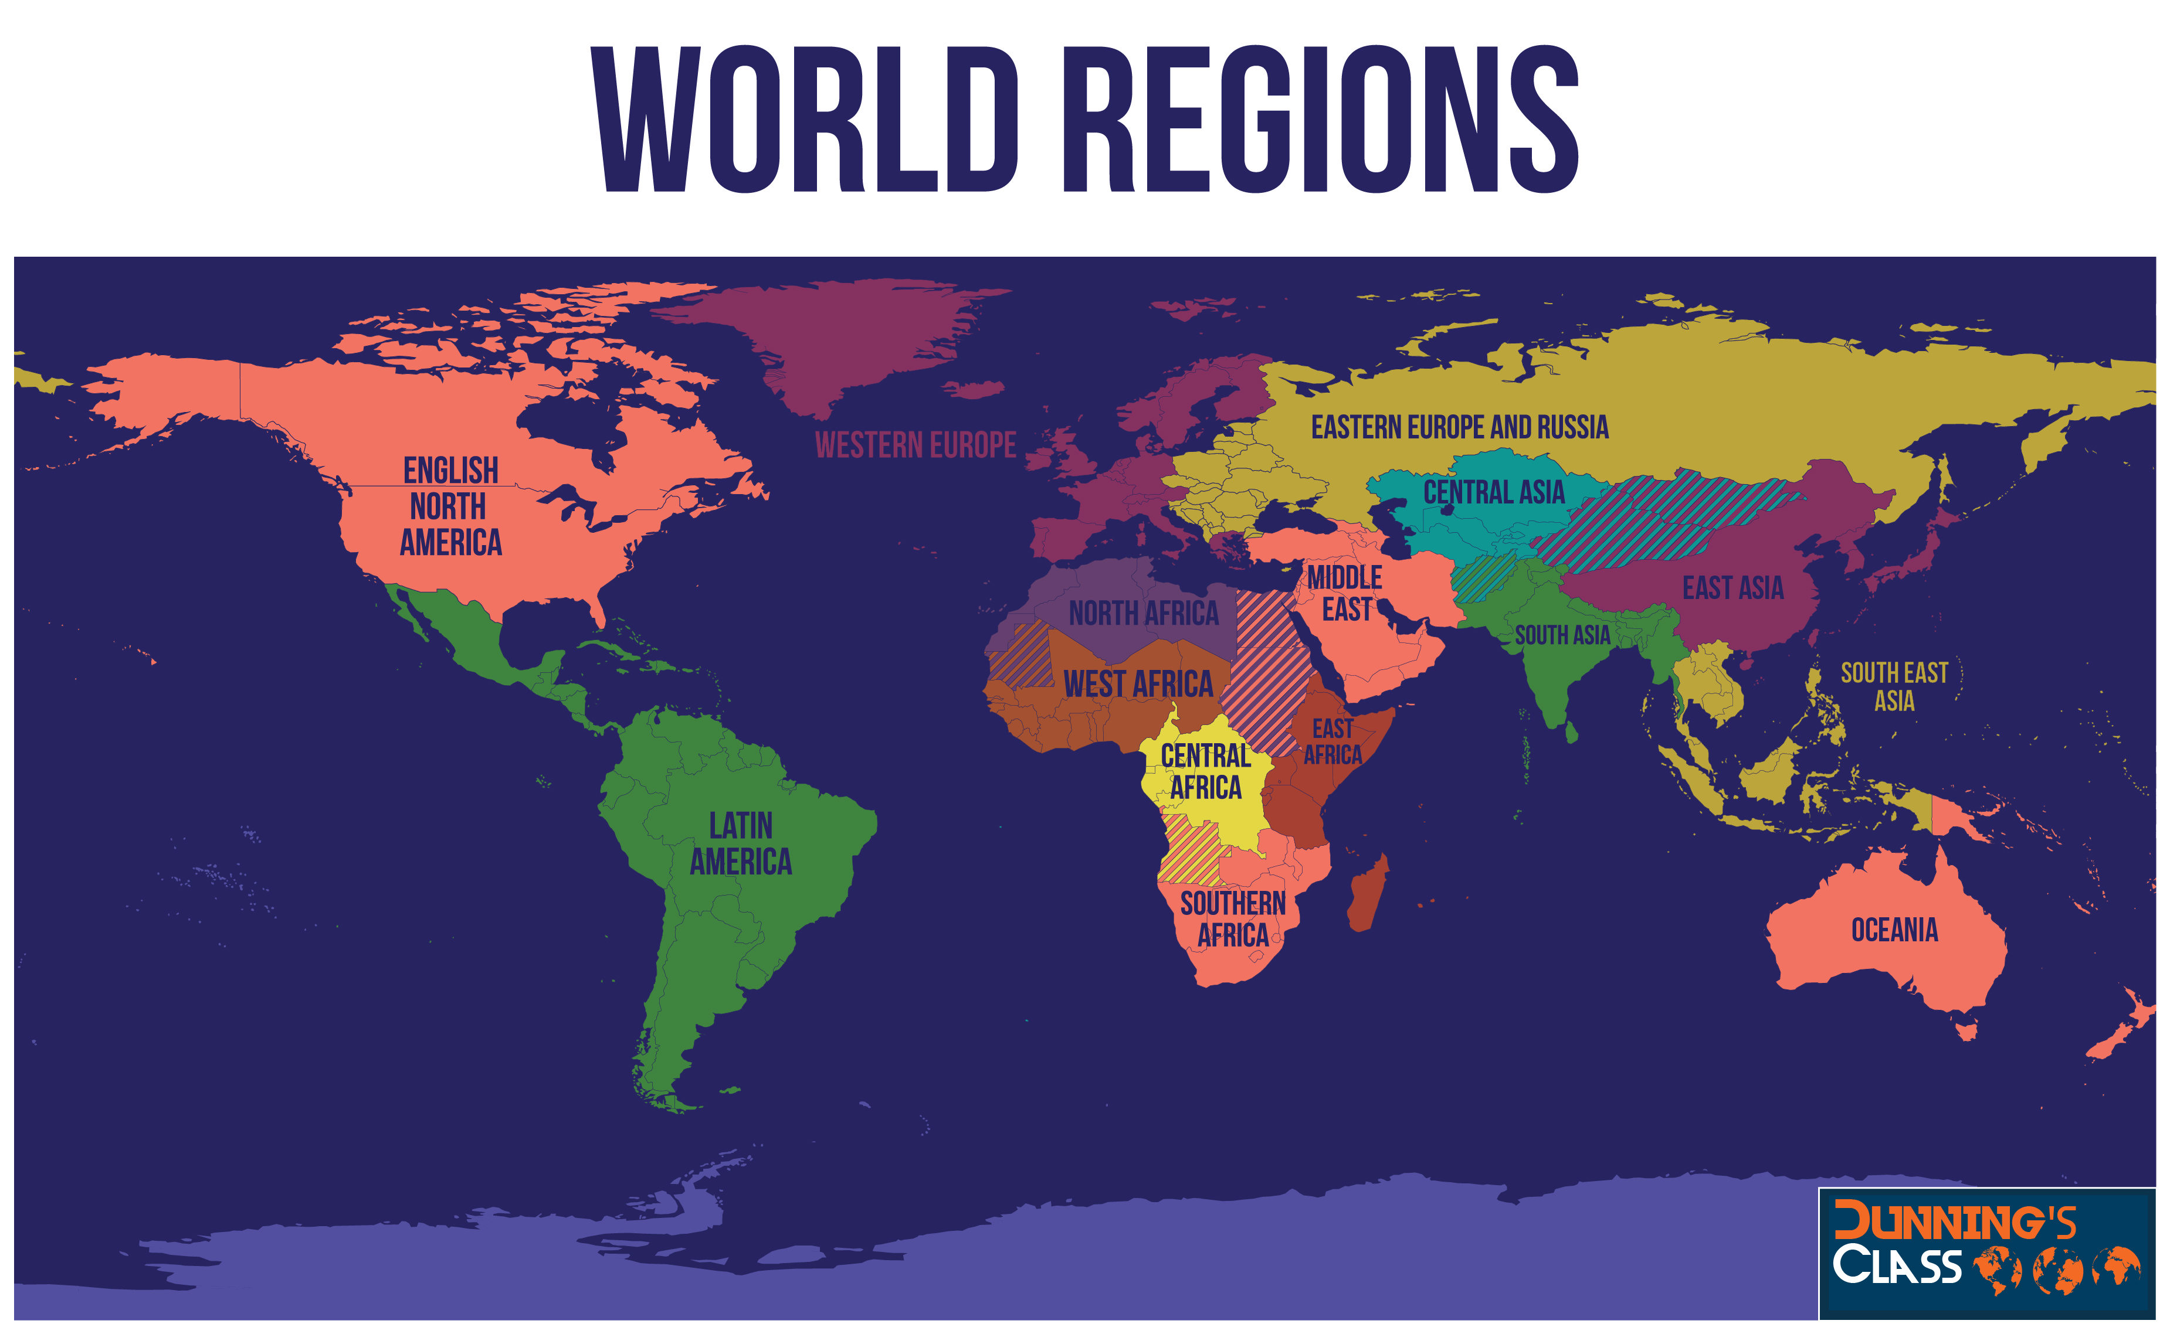
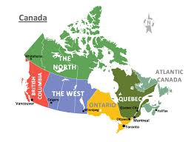
World Regions and Sub Regions
World Regions
Sub-regions share some characteristics with the rest of the large region but is distinctive in some ways

Slide 31
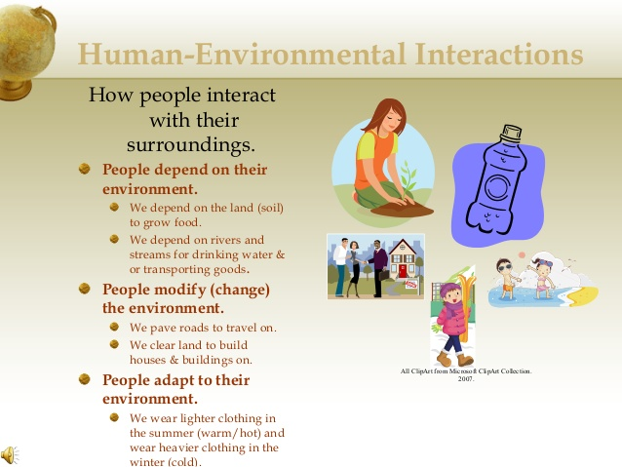

Slide 32
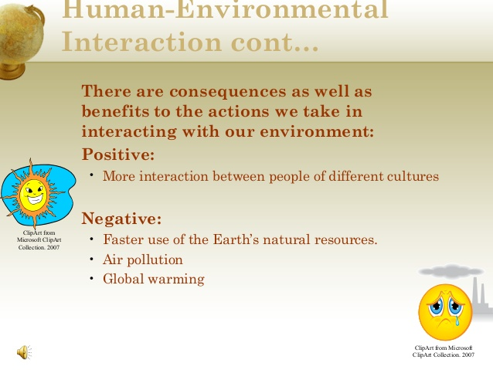

Slide 33
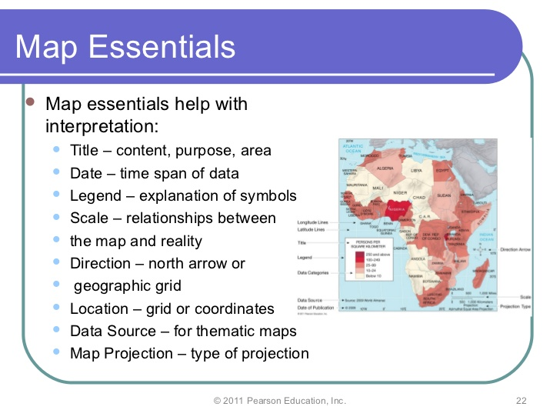
Map Essentials

Slide 34
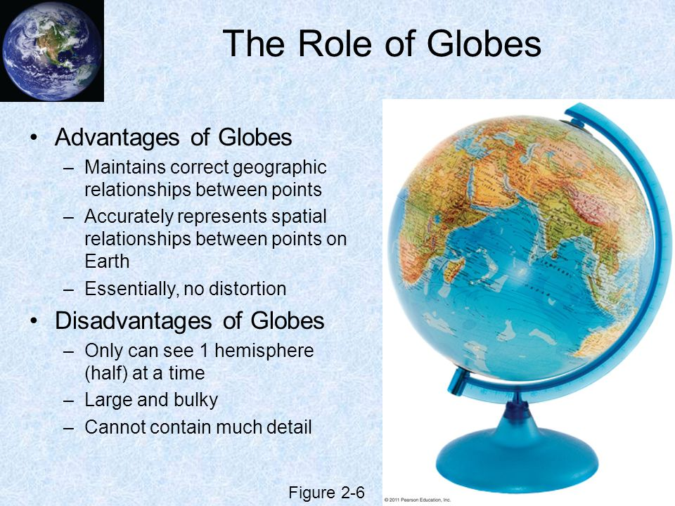
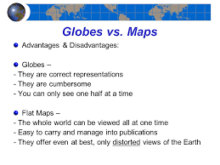
Globes vs maps

Slide 35
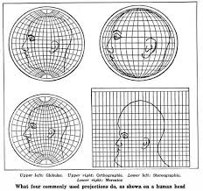
Map Distortions Why all maps are wrong 4 min: https://www.youtube.com/watch?v=kIID5FDi2JQ
Distortion: It is impossible to take the Earth’s round surface and project it onto a flat surface without distortion, or error resulting from the “flattening process
“Projection is the scientific method of transferring location on Earth’s surface to a flat map
Four Properties of Maps
Shape: geometric shapes of objects on the map
Size: relative amount of space taken up on a map by landforms or objects
Distance: the represented distance between objects on the map
Direction: degree of accuracy representing the cardinal directions
Cartographers must decide which properties of maps to distort by thinking about the map’s purpose

Slide 36
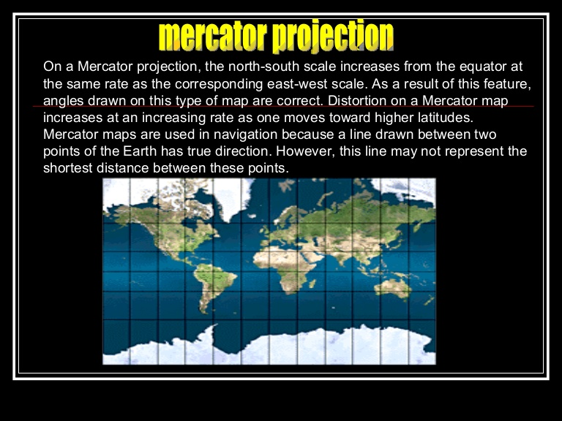
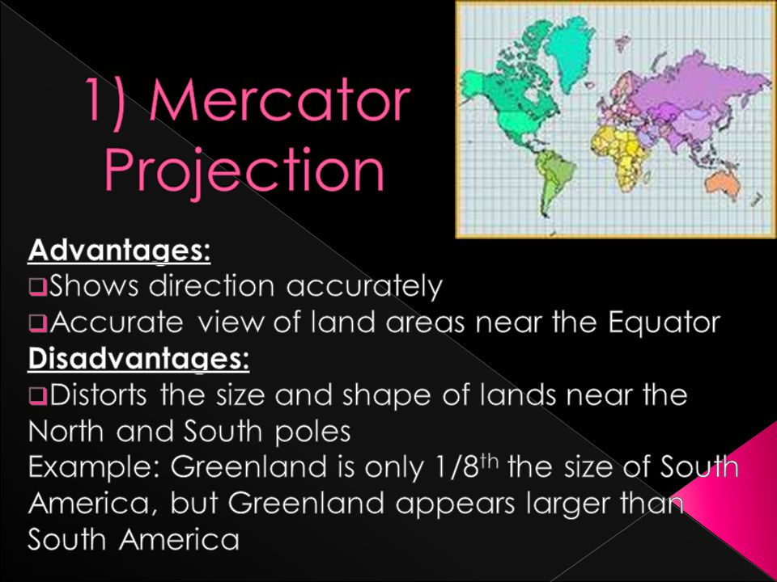
Mercator Projection

Slide 37
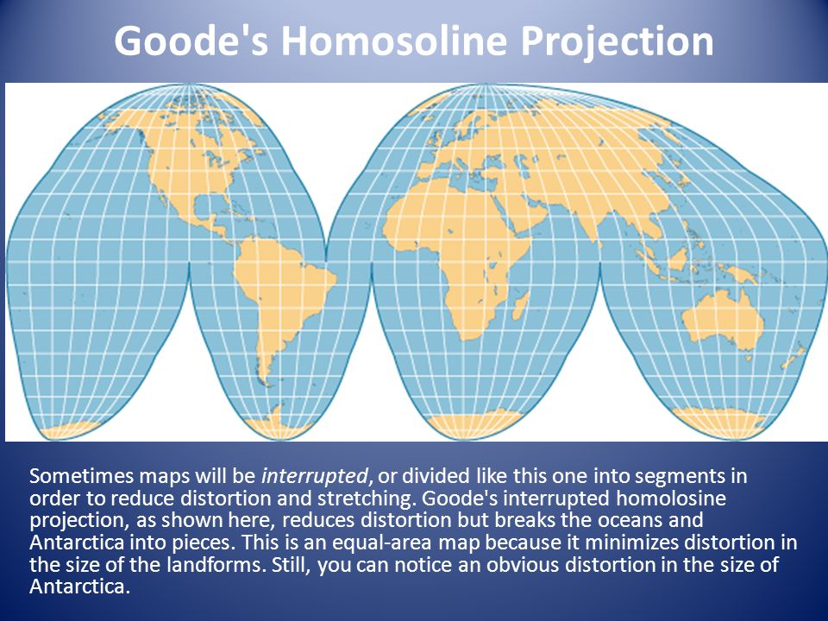
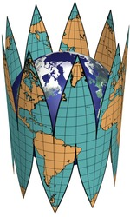
Goode’s Projection Map

Slide 38
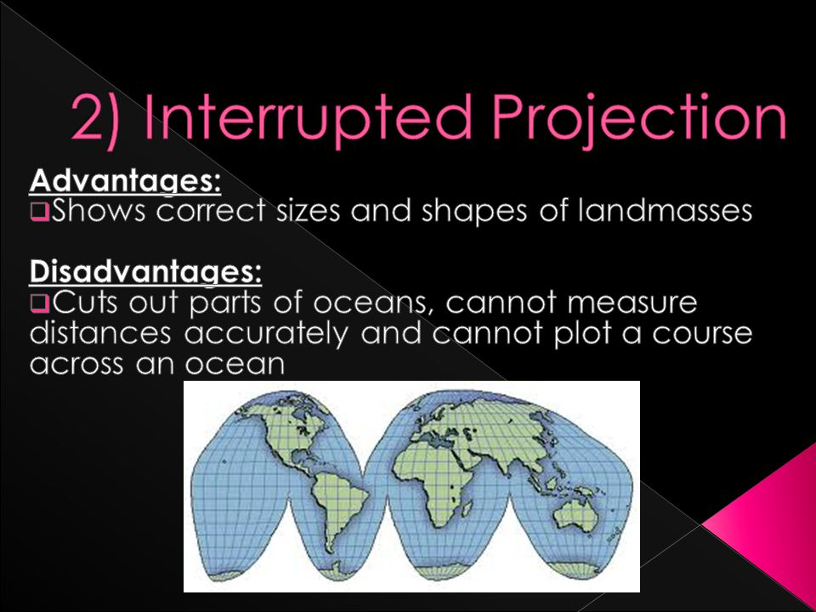
Interrupted Projection

Slide 39
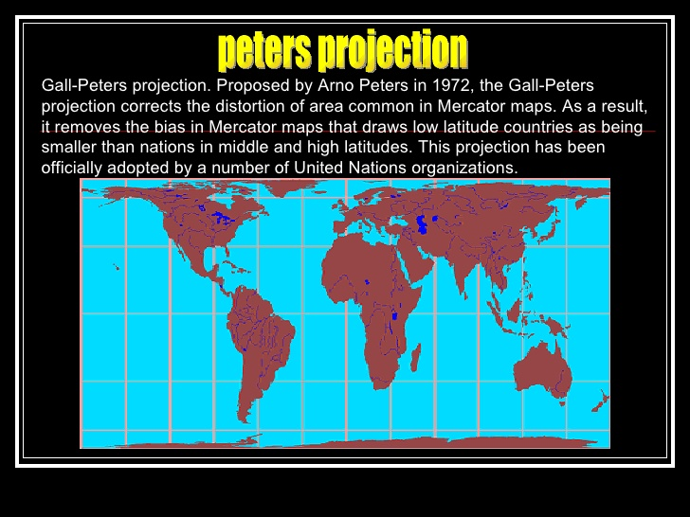
Gall Peters Projection West wing 4 min: https://www.youtube.com/watch?v=vVX-PrBRtTY

Slide 40
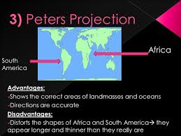
Peters Projection

Slide 41

Comparing Maps

Slide 42


Map Projections

Slide 43


Azimuthal map projection It has the useful properties that all points on the map are at proportionately correct distances from the center point, and that all points on the map are at the correct azimuth (direction) from the center point. A useful application for this type of projection is a polar projection which shows all meridians (lines of longitude) as straight, with distances from the pole represented correctly
Azimuthal map projection
Fuller Projection Map

Slide 44
COMPARING MAP PROJECTIONS
 | Strengths | Distortion | Projections
Navigation | Directions are shown accurately Lines of latitude and longitude meet at right angles | Distance between lines of longitude appears constant Land masses near the poles appear large | Mercator
Spatial Distributions Related to Area | Sizes of land masses are accurate | Shapes are inaccurate, especially near the poles | Peters
General Use in Midlatitude Countries | Lines of longitude converge Lines of latitude are curved Size and shape are both close to reality | Direction is not constant On a world map, longitude lines converge at only one pole | Conic
General Use | No major distortion Oval shape appears more like a globe that does a rectangle | Area, shape, size, and direction are at slightly distorted | Robinson

Slide 45


A map-scale shows the relationship of a feature’s size on a map to its actual size on Earth

Slide 46
Reference Maps: are designed for people to refer to for general information about places
Political Maps | Show and label human created boundaries and designations such as countries, states, cities and capitals
Physical Maps | Show and label natural features, such as mountains, rivers, and deserts
Road Maps | Show and label highways, streets and alleys
Plat Maps | Show and label property lines and details of land ownership
Locator Maps | Are illustrations used in books and advertisements to show specific locations mentioned in the text

Slide 47


Political maps are designed to show governmental boundaries of countries, states, and counties, the location of major cities, and they usually include significant bodies of water
Physical Maps: focuses on the geography of the area and will often have shaded relief to show the mountains and valleys
Political Map
Physical Map

Slide 48


More Maps!
Plat Map Show and label property lines and details of land ownership
Locator Map illustrations used to show specific locations mentioned in the text

Slide 49


Road Map: designed for motorists, showing the roads of a city, state, or other area.
Topographic Map are detailed, accurate graphic representations of features that appear on the Earth's surface. These features include: cultural: roads, buildings, urban development, railways, airports, names of places and geographic features, administrative boundaries, state and international borders, reserves.
Road Map
Topographic Map

Slide 50

A thematic map is a map that emphasizes a particular theme or special topic such as the average distribution of rainfall in an area. They are different from general reference maps because they do not just show natural features like rivers, cities, political subdivisions and highways.

Slide 51


Choropleth Map is a thematic map in which areas are shaded or patterned in proportion to the measurement of the statistical variable being displayed on the map, such as population density per-capita income
A Cartogram is a map in which some thematic mapping variable – such as travel time, population, or Gross National Product – is substituted for land area or distance. The geometry or space of the map is distorted in order to convey the information of this alternate variable.
Choropleth Map
Cartogram Map

Slide 52

Dot distribution map, or dot density map, is a map type that uses a dot symbol to show the presence of a feature or phenomenon. Dot maps rely on a visual scatter to show spatial pattern

Slide 53

Isoline (meaning "equal line") maps use continuous lines (sometimes called isolines or contours) to represent regional differences across a continuous surface. Lines connect places that have the same value of a given feature: temperature or rainfall.

Slide 54
Geospatial Techniques
Geospatial Techniques
Type | Description | Uses
GPS: Global Positioning System | GPS receivers on the earth’s surface use the locations of multiple satellites to determine and record a receiver’s exact location | Precisely locating borders Navigating ships, aircraft, cars Mapping lines (trails) or points (fire hydrants)
Remote Sensing | The use of cameras or other sensors mounted on aircraft or satellites to collect digital images of the earth’s surface | Determining land cover and use Monitoring environmental changes Assessing spread of spatial phenomena Monitoring the weather
GIS: Geographic Information Systems | Computer system that can store, analyze, and display information from multiple digital maps or geospatial data sets. Allows person to visualize patters, relationships and trends | Analysis of crime data Effects of pollution Transportation/travel time analysis Urban planning

Slide 55


GIS / GPS

Slide 56
Geographic Information Science (GIScience): is analysis of data about Earth acquired through satellite and other electronic information technologies
Geocaching: the recreational activity of hunting for and finding a hidden object by means of GPS coordinates posted on a website
Collecting and Sharing Data: VGI
Volunteered Geographic Information (VGI) is the creation and dissemination of geographic data contributed voluntarily and for free by individuals. VGI is part of a broader trends of citizen science which is scientific research by armature scientists and Participatory GIS (PGIS) which is community based mapping. Citizen science and PGIS collect and disseminate local knowledge and information trough electronic deices
Mashup: is a map that overlays data from one source on top of a map provided by a mapping service, The term mashup comes from hip-hop practice of mixing two or more songs.

Slide 57
Regions of Culture
Culture: a body of beliefs, materiel trails, and social forms that together constitute the distinct traditions of a group or people
Culture is what people care about
Geographers study why customary ideas, beliefs and values of a people produce a distinctive culture in a particular location a place
Language: communication
Religion: beliefs and practices
Ethnicity: language, religion, physical traits
Culture: What people take care of
Material wealth food, clothing, shelter
Developed vs. developing regions

Slide 58


Pros and Cons of Globalization

Slide 59


Sustainability is the use of Earth’s resources in ways that ensure their availability in the future. Patterson 17 min https://www.youtube.com/watch?v=6HuKphKJnQk

Slide 60

Renewable resource: is produced in nature more rapidly than it is consumed by humans (wind, hydro, wood, solar, geothermic)
Nonrenewable Resource is produced in nature more slowly than it is consumed by humans (oil, gas, minerals, coal)

Slide 61
Cultural Ecology
Geographic study of human environment relationships – combing culture and environment
Environmental determinism: A 19th- and early 20th-century approach to the study of geography that argued that the general laws sought by human geographers could be found in the physical sciences. Geography was therefore the study of how the physical environment caused human activities. Physical environment causes social development
Possibilism- The physical environment may limit some human actions, but people have the ability to adjust to their environment (this is a rejection of environmental determinism)
EX: people learn to adjust and grow different crops depending on climate
Why plant a front yard? Why not let it grow? How do your cultural values impact the environment?

Slide 62

Modifying the Environment
The Netherlands
Sustainable Ecosystem
Polder: Land created by draining water
Dikes; walls to hold back the water
Concerns about rising sea water from global warming
https://www.cbsnews.com/news/sea-change-how-the-dutch-confront-the-rise-of-the-oceans/

Slide 63
Helpful Videos / Overviews
Patterson Chapter 1 Unit Issue1 Maps: https://www.youtube.com/watch?v=XXhtZXvN1ZI
Chapter 1 Key Issue 2 - Basic Concepts: https://www.youtube.com/watch?v=Fw0CGz-edSs
Patterson Chapter 1 Issue 3 Why are different places similar: https://www.youtube.com/watch?v=9A9J8I-pTzU
Patterson Chapter 1 Key Issue 4, Sustainability: https://www.youtube.com/watch?v=6HuKphKJnQk
Crash Course Unit 1: https://www.youtube.com/watch?v=MzxllMgK4TQ&list=PLsnl7oHcNUt-rjj_hIubKHyGMRjR7yQVH&index=22
Crash Course Unit 1 Part 2: https://www.youtube.com/watch?v=TdV6yAzyBas&index=30&list=PLsnl7oHcNUt-rjj_hIubKHyGMRjR7yQVH
Maps That Prove You Don't Really Know Earth 3 min https://www.youtube.com/watch?v=KUF_Ckv8HbE
Geospatial Revolution / Episode One
https://www.youtube.com/watch?v=poMGRbfgp38&list=PL0C0A2A71BD0BC488&index=1
Stratfor Geographic Challenges videos: Pakistan's Geographic Challenge
Did You Know? Shift Happens, 2014 https://www.youtube.com/watch?v=PcZg51Il9no
Mr. White 15 Minute Review of Unit 1: https://www.youtube.com/watch?v=Lp5v00LMdlM
Mr. White: Diffusion: 10:44: https://www.youtube.com/watch?v=EhiJeUuvCmI
Mr. White’s Maps and distortion 14 min: https://www.youtube.com/watch?v=02qKTIdjv8U
Mr. White’s Regions and Thematic Maps 14 min: https://www.youtube.com/watch?v=KxF1W4mbvwE
Review video for Unit 1 test: https://www.youtube.com/watch?v=44j7_9nnI34

