Slide 1
Social psychology
Chapter 16

Slide 2
Social Psychology
Social psychology
Is the scientific study of how we think about, influence, and relate to one another
Social psychologists
Use scientific methods to study how people think about, influence, and relate to one another
Study the social influences that explain why the same person will act differently in different situations

Slide 3
Social Psychology
Social Thinking
When explaining others’ behavior, especially from an individualist Western cultural perspective
Fundamental attribution error committed by underestimating the influence of the situation and overestimating the effects of stable, enduring traits
Behavior more readily attributed to the influence of the situation
Explaining and attributing actions can have important real-life social and economic effects

Slide 4
Social Psychology
Fundamental attribution error
Is tendency, when analyzing others’ behavior, to overestimate the influence of personal traits and underestimate the effects of the situation
Is most likely to occur when stranger acts badly
Has real-life and social consequences
Napolitan and colleagues (1979)
Students attributed behavior of others to personal traits, even when they were told that behavior was part of an experimental situation.

Slide 5
Social Psychology
Question of attribution
Whether we attribute poverty and homelessness to social circumstances or to personal dispositions affects and reflects our political views.

Slide 6
Social Psychology
Attitudes Affect Actions
Attitudes are feelings influenced by beliefs, that predispose reactions to objects, people, and events.
Peripheral route persuasion uses incidental cues to try to produce fast but relatively thoughtless changes in attitudes.
Central route persuasion offers evidence and arguments to trigger thoughtful responses

Slide 7
Social Psychology
Actions can modify attitudes.
Role playing includes acting a social part by following guidelines for expected behavior
Zimbardo’s Stanford Prison Experiment

Slide 8
Social Psychology
Foot-in-the-door phenomenon
People agreeing to a small request will find it easier to agree later to a larger one
Principle works for negative and positive behavior
Attitudes follow behavior
Cooperative actions, such as those performed by people on sports teams, feed mutual liking. Such attitudes, in turn, promote positive behavior.

Slide 9
Social Psychology
When attitudes do not fit with actions, tensions are often reduced by changing attitudes to match actions (cognitive dissonance theory).
We act to reduce the discomfort (dissonance) we feel when two of our thoughts (cognitions) clash.
Brain regions become active when people experience cognitive dissonance.
Through cognitive dissonance we often bring attitudes into line with our actions (Festinger).

Slide 10
Social Psychology
Conformity and obedience
Chartrand and colleagues (1999)
Demonstrated chameleon effect with college students
Automatic mimicry helps people to empathize and feel what others feel.
The more we mimic, the greater our empathy, and the more people tend to like us.
This is a form of conformity.

Slide 11
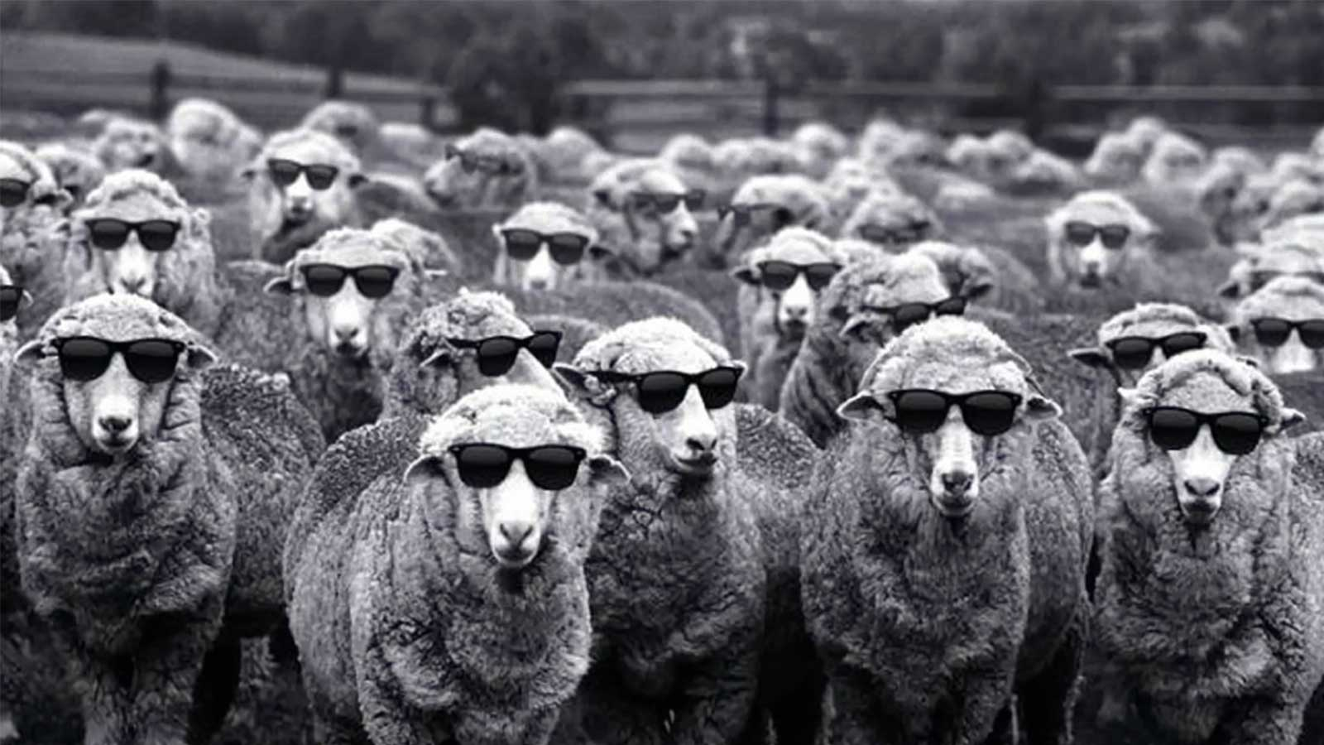
Social Psychology
They feel incompetent or insecure
Their group has at least three people
Everyone else agrees
They admire the group’s status and attractiveness
They have not already committed to another response
They know they are being observed
Their culture encourages respect for social standards
Conformity and Obedience
Solomon Asch and others have found that people are most likely to adjust their behavior or thinking to coincide with a group standard when

Slide 12
ASCH’S CONFORMITY EXPERIMENTS
Which of the three comparison lines on the left is equal to the standard line? The photo on the right (from one of the experiments) was taken after five people, who were actually working for Asch, had answered, “Line 3.” The student in the center shows the severe discomfort that comes from disagreeing with the responses of other group members.

Slide 13
Social Psychology
People May Conform For Many Reasons
Normative social influence: To gain approval
Informational social influence: To accept others’ opinions as new information

Slide 14
Social Psychology
SOCIAL NETWORKING INFLUENCE
On the 2010 U.S. congressional election day, Facebook gave people an informational message that encouraged voting. The message had measurably more influence when supplemented with a social message that showed friends who had voted (Bond et al., 2012).

Slide 15
Social Psychology
Suggestibility and mimicry sometimes lead to tragedy.
Copycat violence threats after Colorado’s Columbine High School shootings

Slide 16
Social Psychology
Stanley Milgram’s Obedience experiments
People obeyed orders even when they thought they were harming another person.
Strong social influences can make ordinary people conform to falsehoods or exhibit cruel behavior.
In any society, great evil acts often grow out of people’s compliance with lesser evils.
In a repeat of the earlier experiment, 65 percent of the adult male “teachers” fully obeyed the experimenter’s commands to continue. They did so despite the “learner’s” earlier mention of a heart condition and despite hearing cries of protest after they administered what they thought were 150 volts and agonized protests after 330 volts. (Data from Milgram, 1974.)

Slide 17
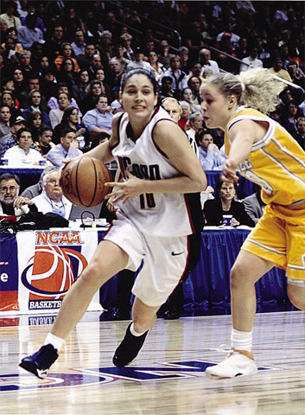
Social Psychology
Home team advantage
When others observe us, we perform well-learned tasks more quickly and accurately.
But on new and difficult tasks, performance is less quick and accurate.
In social facilitation (Triplett), presence of others arouses people, improving performance on easy or well-learned tasks but decreasing it on difficult ones.
Performance can also be hindered because the most likely, but not necessarily the correct response occurs.
Home town advantage
Crowding effect

Slide 18
Social Psychology
Social loafing
Tendency for people in a group to exert less effort when pooling their efforts toward attaining a common goal than when individually accountable
Causes
Acting as part of group and feeling less accountable
Feeling individual contribution does not matter
Taking advantage when there is lack of identification with group
There is always that one person in the group project that doesn’t do work

Slide 19
Social Psychology
Deindividuation
Involves loss of self-awareness and self-restraint occurring in group situations that foster arousal and anonymity
Thrives in many different settings
Violent Anti-Trump Rioters

Slide 20
Social Psychology
Group polarization
Group discussions with like-minded others strengthen members’ prevailing beliefs and attitudes.
Internet communication magnifies this effect, for better and for worse
If a group is like-minded, discussion strengthens its prevailing opinions.
Talking over racial issues increased prejudice in a high-prejudice group of high school students and decreased it in a low-prejudice group (Myers & Bishop, 1970).

Slide 21
Social Psychology
Groupthink
People are driven by a desire for harmony within a decision-making group, overriding realistic appraisal of alternatives.

Slide 22
Social Psychology
Individual power
Power of the individual and the power of the situation interact.
A small minority that consistently expresses its views may sway the majority.
Malala

Slide 23
Social Psychology
Social Psychology
Prejudice
Means “prejudgment”
Is an unjustified negative attitude toward some group and its members
Often targets different cultural, ethnic, or gender group

Slide 24
Social Psychology
Prejudice Components
Beliefs
Emotions
Predispositions to action (to discriminate)

Slide 25
Social Psychology
Prejudice is a negative attitude
Discrimination is a negative behavior.
Explicit prejudice in North America has decreased over time.
Support for all forms of racial contact, including interracial dating

Slide 26
Social Psychology
Social roots of prejudice
Social inequalities: Have often developed attitudes that justify status quo
Just-world phenomenon: Good is rewarded and evil is punished.
Stereotypes: Rationalize inequalities.

Slide 27
Social Psychology
Groups
Through social identities people associate themselves with others.
Evolution prepares people to identify with a group
Ingroup/Outgroup: Social definition of who we are—and are not
Ingroup bias: Favoring of our own group

Slide 28
Social Psychology
Scapegoat theory
Proposes that when things go wrong, finding someone to blame can provide an outlet for anger
Research evidence (Zimbardo)
Prejudice levels tend to be high among economically frustrated people
In experiments, a temporary frustration increases prejudice

Slide 29
Social Psychology
Implicit prejudice
Implicit racial associations
Implicit Association Tests results: Even people who deny racial prejudice may carry negative associations
Unconscious patronization
Lower expectations, inflated praise and insufficient criticism for minority student achievement
Race-influenced perceptions
Automatic racial bias
Reflexive bodily responses
Unconscious, selective responses when looking at faces

Slide 30
Social Psychology
Forming categories
Humans categorize people by race: mixed-race people identified by minority identity
Similarities overestimated during categorization; creating “Us and They”
Overestimation also occurs; other-race effect or bias

Slide 31
Social Psychology
The Biology of Aggression
Biology influences aggression at three levels.
Genetic influences
Evidence from animal studies and twin studies; genetic Y chromosome genetic marker; MAOA gene
Alcohol associated with aggressive responses to frustration
Neural influences
Neural systems facilitate or inhibit aggression when provoked
Aggression more likely to occur with frontal lobe damage
Biochemical influences
Testosterone linked with irritability, assertiveness, impulsiveness, and low tolerance for frustration; alcohol effect

Slide 32
Social Psychology
Psychological and Social-Cultural Factors in Aggression
Adversive events
Frustration-aggression principle: Frustration creates anger, which can spark aggression
Other anger triggers
Hot temperatures, physical pain, personal insults, foul odors, cigarette smoke, crowding, and a host of others
Previous reinforcement for aggressive behavior, observing an aggressive role model, and poor self-control

Slide 33
Social Psychology
Psychological and Social-Cultural Factors in Aggression
Media portrayals of violence provide social scripts that children learn to follow.
Viewing sexual violence contributes to greater aggression toward women.
Playing violent video games increases aggressive thoughts, emotions, and behaviors

Slide 34
Social Psychology
Psychological and Social-Cultural Influences on Aggression
Do violent video games teach social scripts for violence?
Nearly 400 studies of 130,000 people suggest video games can prime aggressive thoughts, decrease empathy, and increase aggression.
Some researchers dispute this finding and note other factors: Depression, family violence, and peer influence.
As a player of first-person shooter games, Breivik stirred debate when he commented that “I see MW2 [Modern Warfare 2] more as a part of my training-simulation than anything else.” Did his violent game playing contribute to his violence, or was it a mere coincidental association? To explore such questions, psychologists experiment.

Slide 35
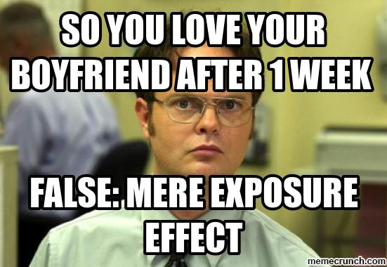
Social Psychology
Prosocial Relations
Psychology of attraction
Proximity (mere exposure effect)
Physical attractiveness
Similarity of attitudes and interests
WHAT DO WE MEAN BY “ATTRACTIVE”?

Slide 36
Social Psychology
Modern matchmaking
Internet-formed friendships and romantic relationships are on average slightly more likely to last and be satisfying.
Nearly a quarter of heterosexual and two-thirds of same-sex couples met online.

Slide 37
Social Psychology
Speed-dating
Men are more transparent.
Choices may be more superficial.
Women are more choosy than men.

Slide 38
Social Psychology
Passionate love
Two-factor theory of emotion
Emotions have two ingredients—physical arousal and cognitive appraisal.
Arousal from any source can enhance an emotion, depending on how we interpret and label the arousal.
Sexual desire + a growing attachment = the passion of romantic love
Passionate love seldom endures
Companionate love
Passion-fed hormones (testosterone) give way to oxytocin that supports feelings of trust, calmness, and bonding
Attraction and sexual desire endure, without obsession of early-stage marriage
Equity is important key to satisfying and enduring relationship
Self-disclosure deepens intimacy

Slide 39
Social Psychology
Altruism is an unselfish concern for the welfare of others.
People are most likely to help when they notice an incident, interpret it as an emergency, and assume responsibility for helping (Darley and colleagues).
Odds for being helped are also increased if the person appears to deserve help or is a women.
Similarity to self, unhurried or in a good mood, feeling guilty, focused on others and not preoccupied also raises likelihood of being helped.

Slide 40
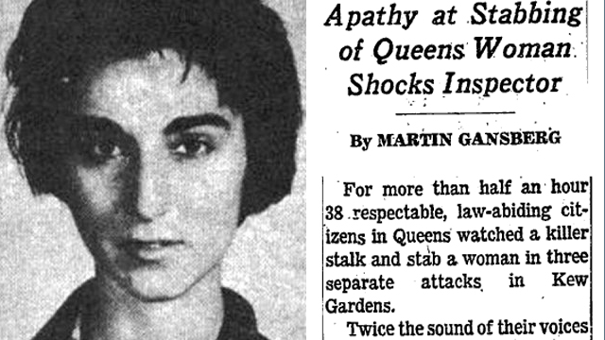
Social Psychology
Bystander affect
Tendency for any given bystander to be less likely to give aid if other bystanders are present
Occurs when there is a diffusion of responsibility

Slide 41
Social Psychology
Positive social norms encourage generosity and enable group living.
Socialization norm
Social expectation that prescribes how we should behave
Reciprocity norm
Expectation that people will respond favorably to each other by returning benefits for benefit (cost-benefit analysis; utilitarianism; social exchange theory)
Social-responsibility norm
Expectation that people should help those who depend on them

Slide 42
Social psychology

Slide 43
Social psychology
Conflict
Perceived incompatibility of actions, goals, or ideas in which people become enmeshed in potentially destructive processes that often produce unwanted results
Among these processes are social traps and distorted perceptions

Slide 44
Social psychology
Social trap
Situation in which conflicting parties, by each pursuing their self-interest rather than the good of the group, become caught in mutually destructive behavior
Mirror-image perceptions
Mutual views often held by conflicting people, as when each side sees itself as ethical and peaceful and views the other side as evil and aggressive

Slide 45
Social psychology
Enemy perceptions
People in conflict form negative, distorted images of one another (mirror-image perceptions)
“Us” versus “Them” develops
Vicious cycle of hostility emerges at individual or national level
Perceptions can become self-fulfilling prophecies

Slide 46
Social psychology
Research indicates that in some cases contact and cooperation can be transformational.
Contact
Most effective when contact is free of competition and equal status exists
Across a quarter-million people studied in 38 nations, friendly contact with ethnic minorities, older people, and people with disabilities has usually led to less prejudice.
Contact is not always enough.

Slide 47
Social psychology
Promoting Peace
Cooperation
Communication
Conciliation

