Slide 1
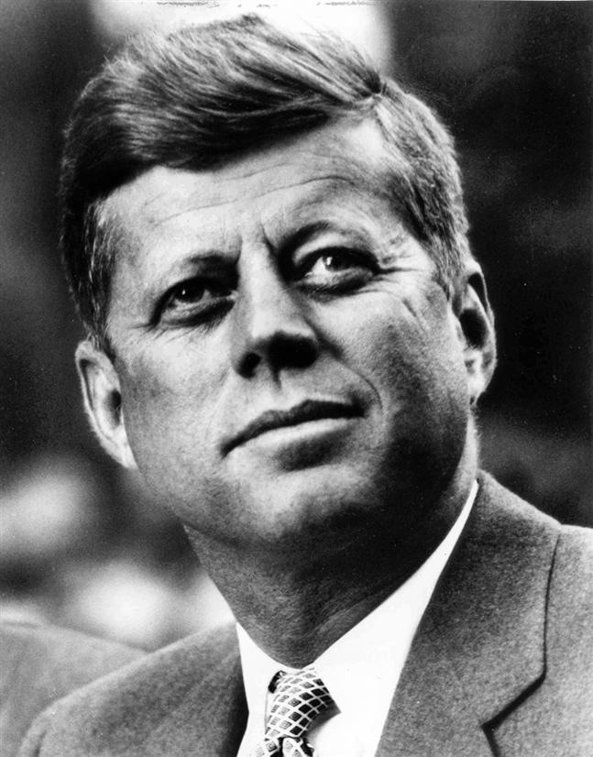
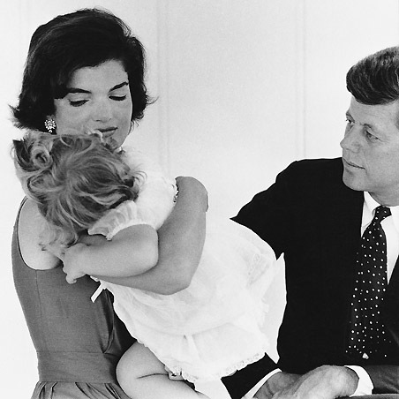
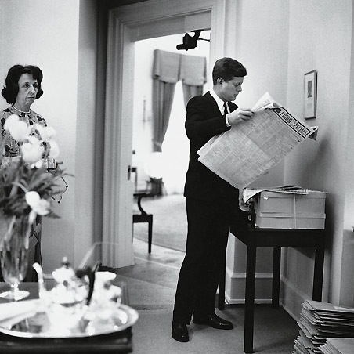
facebook
Wall
Photos
Flair
Boxes
John F. Kennedy
Logout
John F. Kennedy is preparing to sign the Nuclear Test Ban Treaty
Wall
Info
Photos
Boxes
Basic Information
Networks: Washington D.C.
Sex: Male
Birthday: May 29, 1917
Hometown: Brookline, Massachusetts
Relationship Status: Married to Jacqueline Kennedy
Political Views: Democrat
Religious Views: Catholic
View photos of JFK (5)
Send JFK a message
Poke message
Personal Information
Information
Activities: Commanding the Army, making peace with the Soviet Union, promoting civil rights,
Interests: Sailing, Football, Summers in Hyannis, Space Exploration
Favorite Music: Frank Sinatra, Dean Martin, Sammy Davis, Jr.
Favorite Movies: Some Like it Hot, Gentleman Prefer Blondes, Ocean’s Eleven, Guys and Dolls
Favorite TV Shows: The Ed Sullivan Show, The Frank Sinatra Show, To Tell the Truth
Favorite Books: The Road Not Taken, From Russia With Love, Marlborough, Decline and Fall of the Roman Empire
Networks:
Washington D.C.
Birthday:
May 29, 1917
Political:
Democrat
Religion:
Catholic
Hometown:
Brookline, Mass.
Photos
Contact Information
2 Albums
Address: 1600 Pennsylvania Avenue NW, Washington, DC 20500
Phone Number: (202) 456-1111
The Family
Updated last Tuesday
White House
Updated two months ago

Slide 2
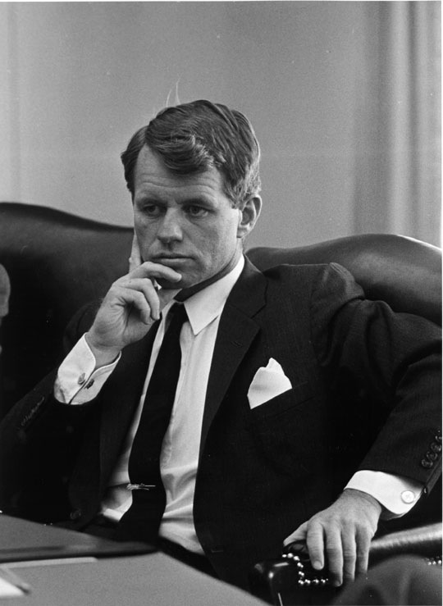
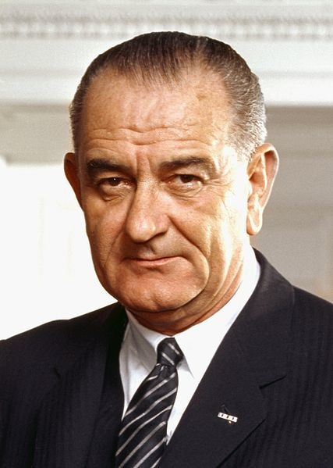
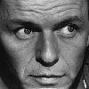
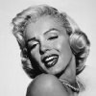
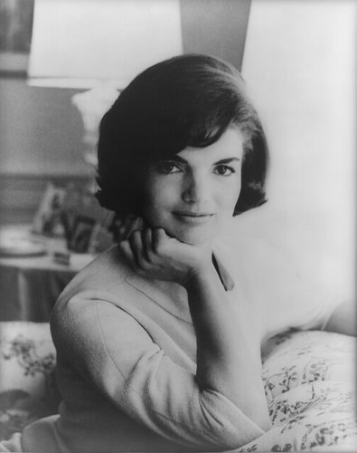
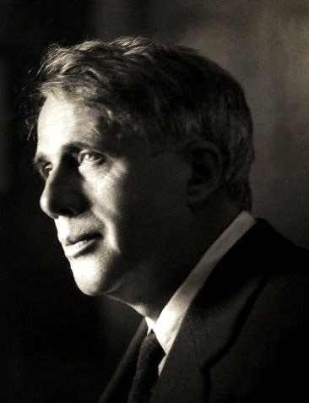
facebook
Wall
Photos
Flair
Boxes
John F. Kennedy
Logout
John F. Kennedy is preparing to sign the Nuclear Test Ban Treaty
Wall
Info
Photos
Boxes
Write something…
Share
View photos of JFK (5)
Send JFK a message
John F. Kennedy is preparing to sign the Nuclear Test Ban Treaty
October 7, 1963
Poke message
Bobby Kennedy to John F. Kennedy Have you finalized your plans for the Texas trip?
October 1, 1963
Information
Networks:
Washington D.C.
Birthday:
May 29, 1917
Political:
Democrat
Religion:
Catholic
Hometown:
Brookline, Mass.
John F. Kennedy I can’t believe I had to actually send the National Guard to Alabama just so some kids could go to college!
June 11, 1963
John F. Kennedy is so glad we avoided war with the Russians! That Crisis in Cuba had my blood boiling!
October 28, 1962
Friends
John F. Kennedy hopes everyone realizes how serious I am about putting a man on the moon!!!
September 9, 1962
LBJ
Frank
Marilyn
John F. Kennedy wishes the Bay of Pigs invasion had gone better! I think Castro is going to be a major thorn in the side of the U.S.
April 17, 1961
Bobby
Jackie
Robert

Slide 3
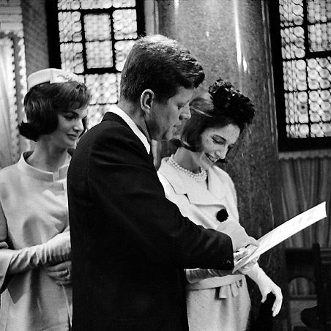
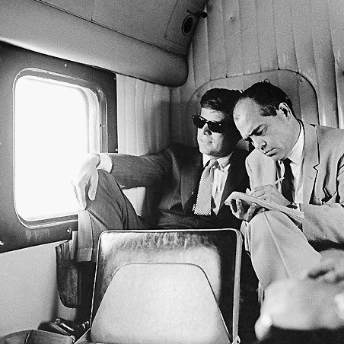
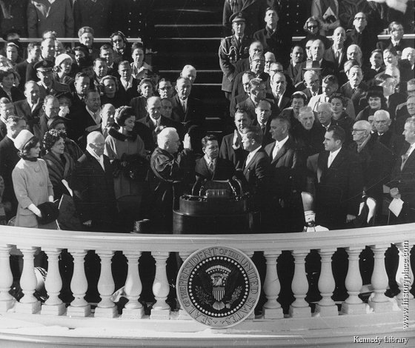
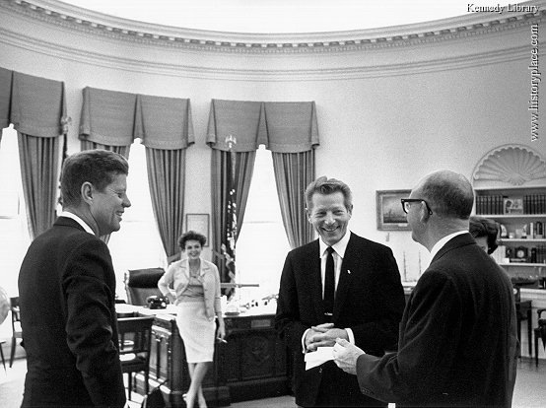
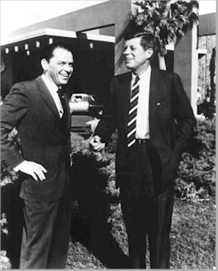
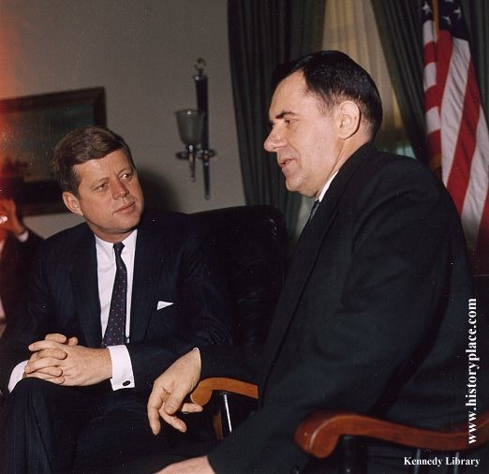
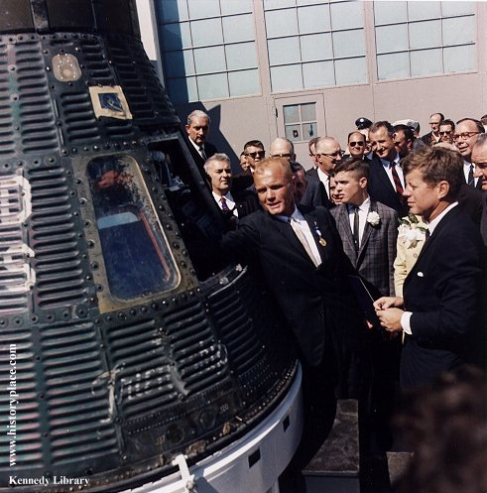
facebook
Wall
Photos
Flair
Boxes
John F. Kennedy
Logout
John F. Kennedy is preparing to sign the Nuclear Test Ban Treaty
Wall
Info
Photos
Boxes
Photos of JFK 7 Photos
JFK’s Albums 2 Photo Alums
The Family
5 photos
The White House
5 photos
Profile Pictures
1 photo

