Slide 1
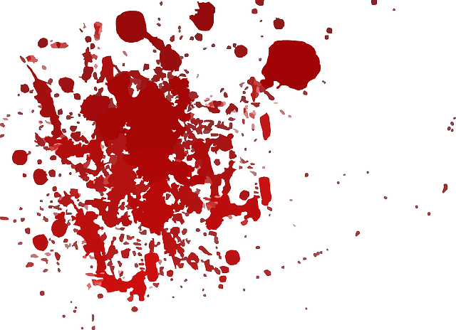
Skin Wounds
Warning:
Some pictures and videos are graphic in nature

Slide 2
What would you do?

Slide 3
Skin Wounds
Wound – trauma to tissues that causes a break in that tissue

Slide 4
5 Types of Skin Wounds
Abrasions
Skin is scraped against a rough surface
Top layer of skin is worn away
Prone to infection – mixed with dirt and debris

Slide 5
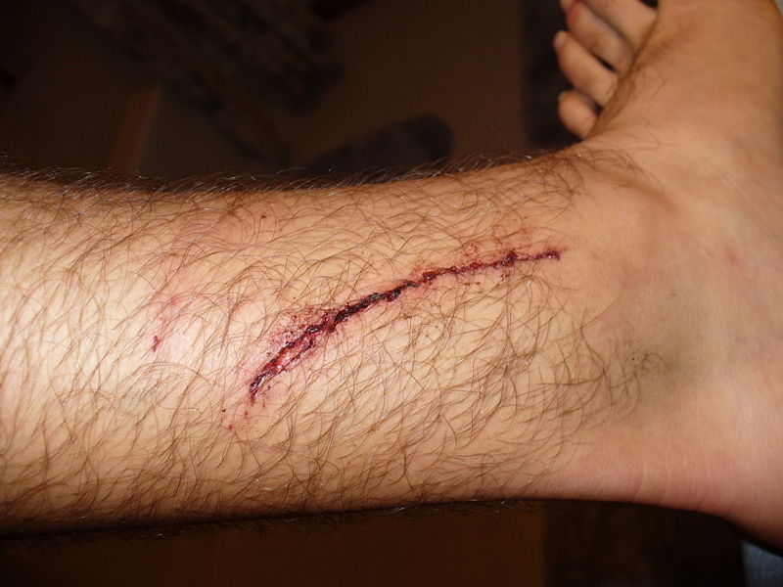
5 Types of Skin Wounds
Laceration
Sharp or pointed object tears tissues
Jagged or rough edge cut

Slide 6
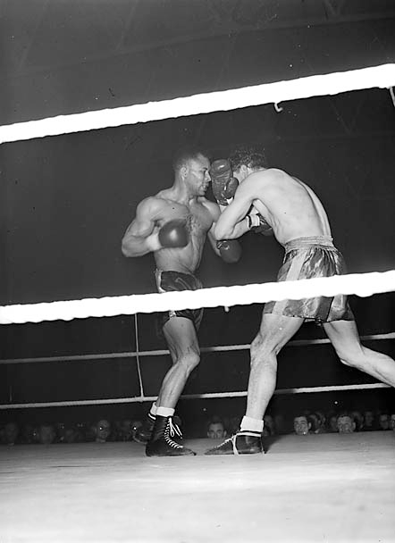
5 Types of Skin Wounds
Incision
Smooth edges
Often when a hit occurs over a sharp bone
Above the eye

Slide 7
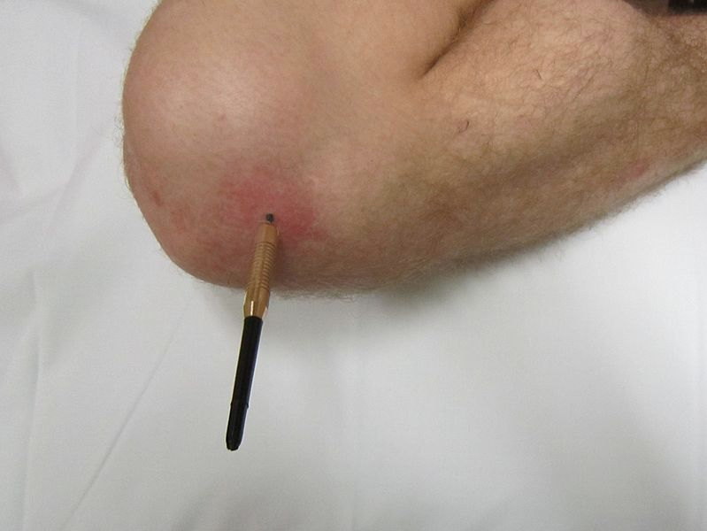
5 Types of Skin Wounds
Puncture
An object penetrates or sticks into the skin
Can be fatal and cause tetanus infection
Nail or cleat sticking in the skin

Slide 8
5 Types of Skin Wounds
Avulsion
Skin is torn away and usually major bleeding
Sometimes tissue can be reattached

Slide 9
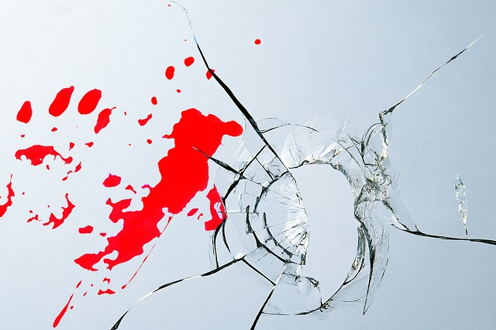
Skin Wound Videos
http://www.youtube.com/watch?v=XAJ_QXRVSZ8
http://www.youtube.com/watch?v=yB590CwJYb0

Slide 10
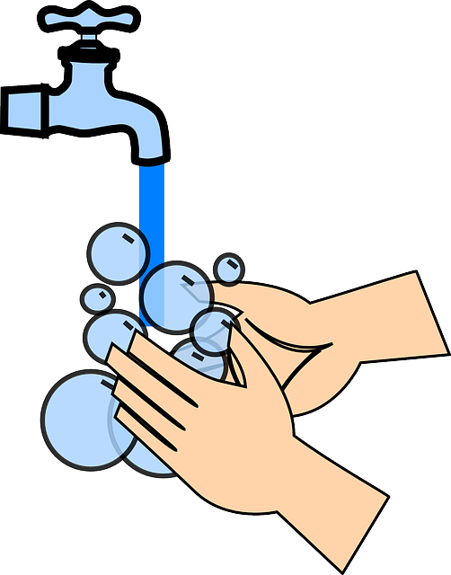
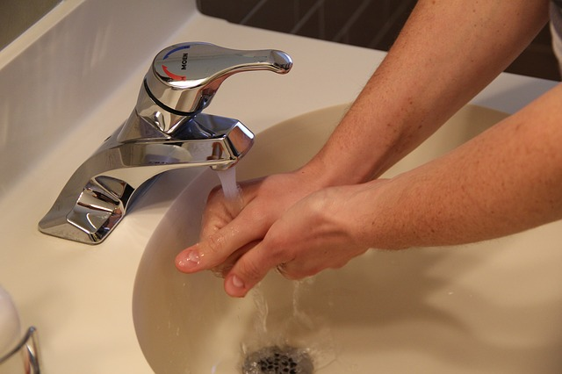
Immediate Care
Must be cleaned, medicated, and covered
Clean with soap and water initially
Decrease chance of infection

Slide 11
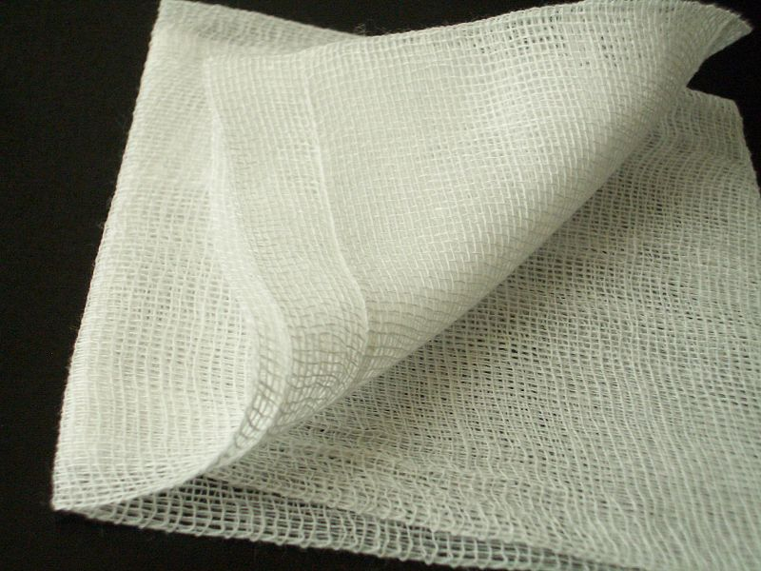
Wound Dressings or Coverings
Dressing should be changed daily
If wound is draining, it must be changed often to decrease bacteria growth
Antibiotic ointments are recommended
Good care will reduce inflammation

Slide 12
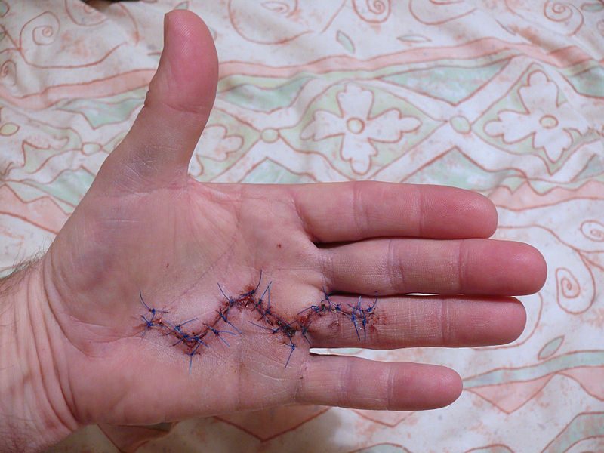
Closing a Wound
Deep lacerations, incisions, punctures, and avulsions may require sutures or stitches
All deep wounds should be evaluated by a doctor
Sutures should be done as soon as possible
Needs to be within 12 hours of injury

Slide 13
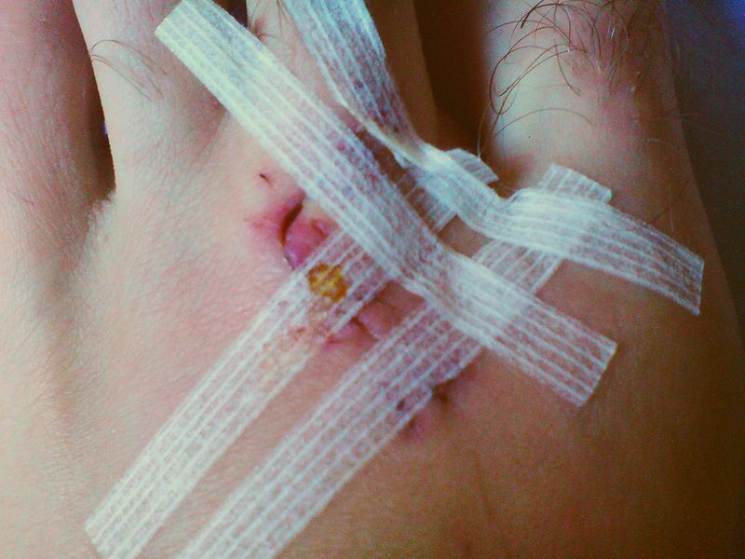
Closing a Wound
If no sutures are required, steri-strips or butterfly bandages may be used

Slide 14
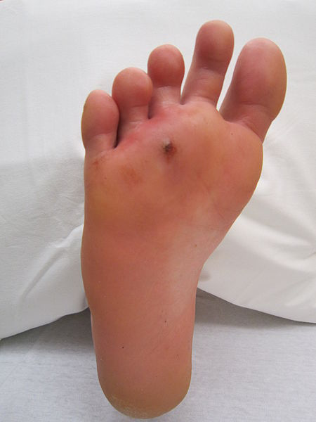
Signs of Infection
Signs are the same as those for inflammation
Pain, heat, redness, swelling
Pus may form (buildup of white blood cells)
May have a fever
Most infections treated by antibiotic medications

Slide 15
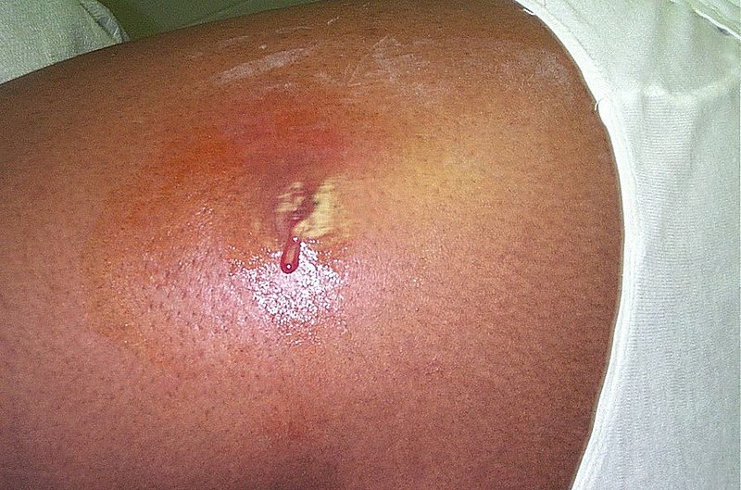
Types of Infections: MRSA
MRSA : methicillin-resistant staphylococcus aureus
Bacteria found on skin (type of Staph infection)
Resistant to antibiotics (difficult to treat)
Recognize early
Skin infections may spread and become life threatening

Slide 16
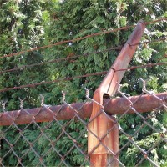
Types of Infections: Tetanus
Tetanus
Bacterial infection
Causes fever and convulsions (muscle spasms)
Often associated with puncture wounds
Childhood vaccine; booster shot every 10 years

Slide 17
Wound Scenarios
1. A basketball player gets a cut above his eye after being elbowed. It is bleeding profusely.
What type of wound is it? What would you do to control the bleeding and close the wound?
2. How would you clean and cover a large abrasion?

Slide 18
END

Slide 19
Review: Ticket Out
What is the type of skin wound?
What is the immediate treatment for most skin wounds?
Which type may require stitches?
What are four signs of infection?

Slide 20
Individual Assignment Quiz
1.
2.
3.
1. What is the type of skin wound? (in order 1-5)
2. What is the immediate treatment for most skin wounds?
3. Which four types may require stitches?
4. What are four signs of an infection?
5. What stage of healing occurs in the first 2 days after an injury?
6. In what stage of healing would a person apply heat, get a massage, or weight a brace to provide support?
7. When would a person apply ice to an injury?
8. Why would a person apply ice to an injury?
9. When would a person apply heat to an injury?
10. Why would a person apply heat to an injury?
4.
5.
.

